Slide 1
Streetwise Lesson 5
Learning Objectives:
To be able to use maps to plan a safe active route.
To understand that planning a route in advance can minimise risk.

Slide 2
Let’s recap….. What have you learnt about road safety so far?

Slide 3
What changes for you in September?
How will you travel to your new school?

Slide 4
What do these show you?
Department for Transport July 2015

Slide 5
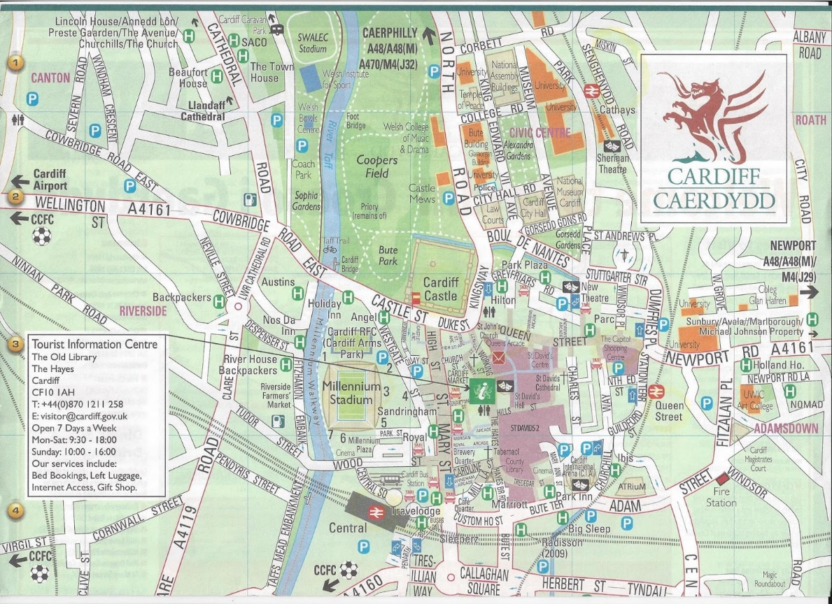
Use your map to find your home and your school….
https://www.cardiff.gov.uk/ENG/resident/Parking-roads-and-travel/Walking-and-cycling/Pages/Walking-and-cycling.aspxSlide 5

Slide 6
Put the obstacles of your journey onto your line journey.
Leave home
Arrive safely at school
Junction: cross at zebra crossing (eg)

