Slide 1
Active Travel Lesson 10
Learning Objective:
To understand how to plan a safe, active journey.
What Matters:
Our decision-making impacts on the quality of our lives and the lives of others.

Slide 2
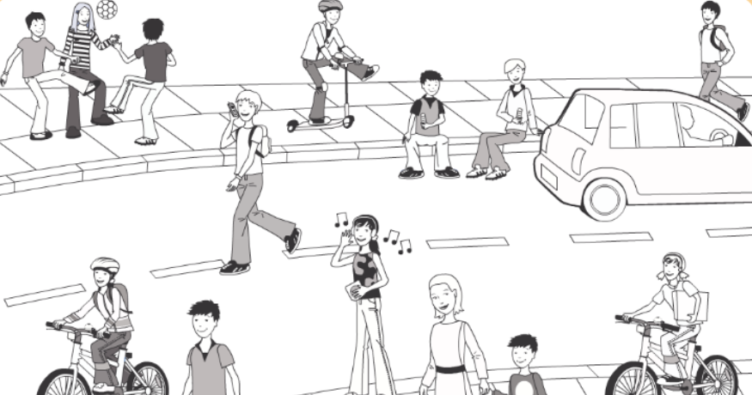
Let’s recap on how to be safe.
Play the game as a class.
https://roadsafety.scot/learning-zone/second/safe-behaviour/

Slide 3
Can you remember the accidents near your home on the Think Map?
Why are the accidents in those locations?
https://www.think.gov.uk/thinkmap/

Slide 4
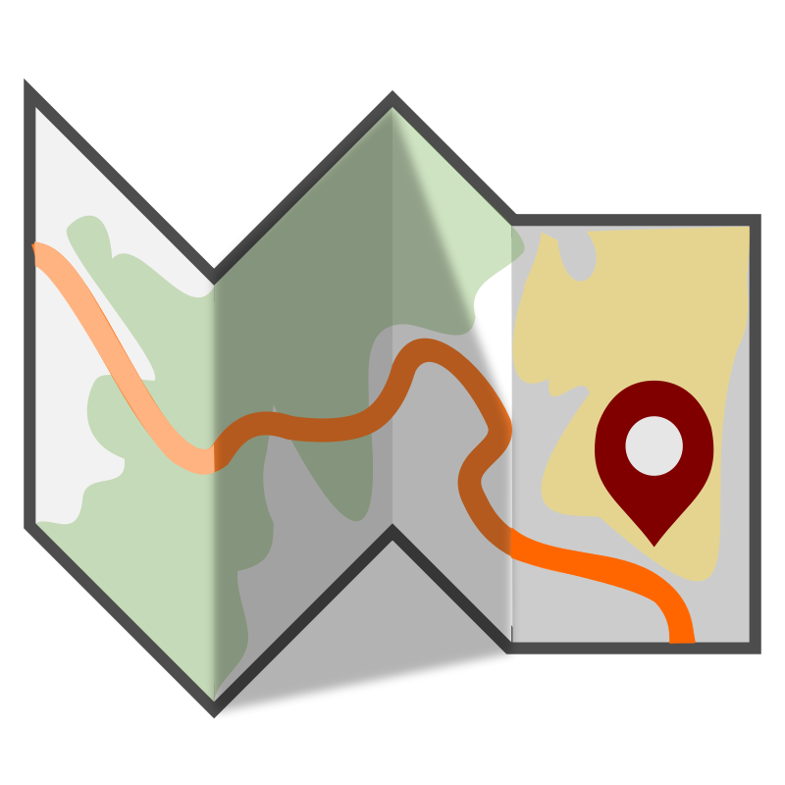
Where do you see maps?
What do people use them for?

Slide 5
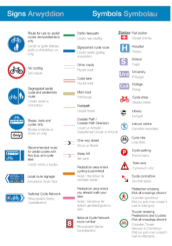
Can you find your home and school on this map?
https://www.cardiff.gov.uk/ENG/resident/Parking-roads-and-travel/Walking-and-cycling/Pages/Walking-and-cycling.aspx

Slide 6
Can you create a new route?

Slide 7
Plenary
Did anyone find a new route?
Can anyone try their new route tomorrow?

