Slide 1
Active Travel Lesson 12
Learning Objective:
To be able to design an active street.
What Matters:
Developing physical health and well-being has lifelong benefits.
How we process and respond to our experiences affects our mental health and emotional well-being.
Our decision-making impacts on the quality of our lives and the lives of others.
How we engage with different social influences shapes who we are and our health and well-being.
Healthy relationships are fundamental to our sense of belonging and well-being.

Slide 2
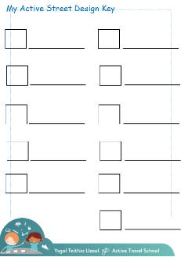
Let’s recap the 5 categories for an Active Street.
Think about what you included in your key.

Slide 3
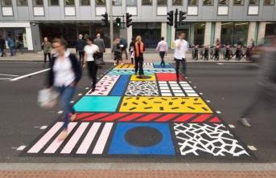
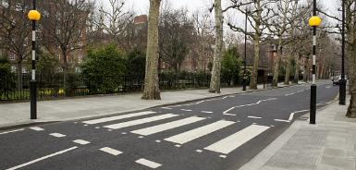
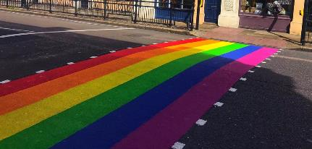
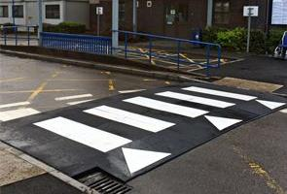
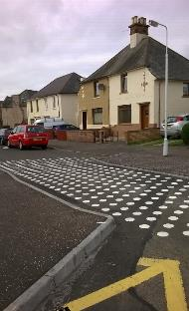
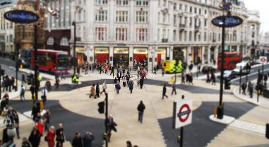
Easy roads to cross
To give a space to walk, cycle and scoot helping us get to places safely.
Colourful crossings
Zebra crossings
Diagonal crossings
Road narrowings
Raised crossings

Slide 4
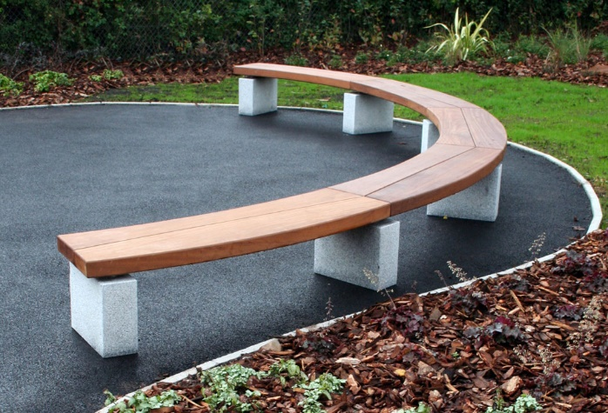
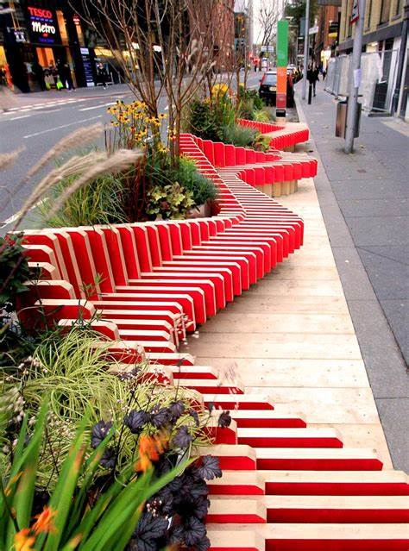
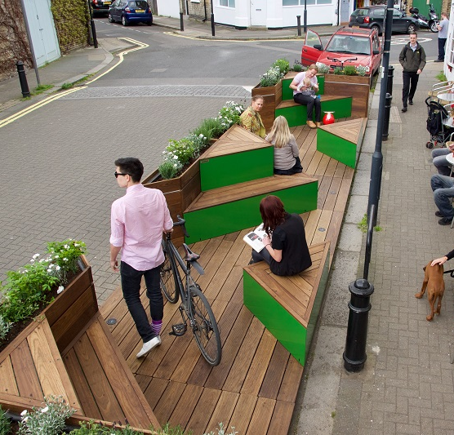
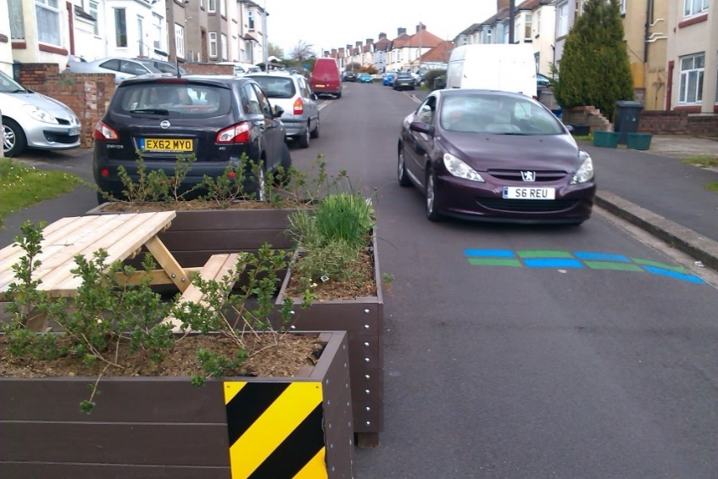
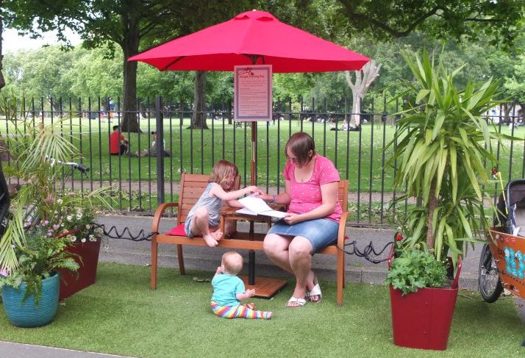
2. Places to stop and rest
To give space outdoors for people to talk to one another and give space to sit, rest and help us relax.
Benches
Parklets
Areas to relax
Grassy areas

Slide 5
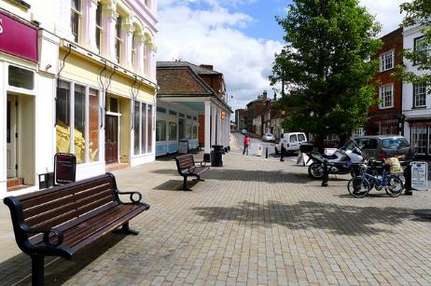
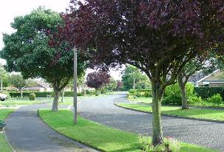
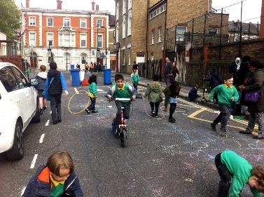
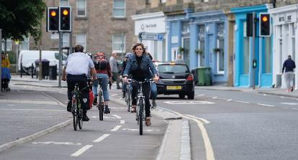
3. Makes active travel easier
To give a space to walk, cycle and scoot helping us get to places safely.
Wide pavements
Closing streets to cars
Cycle lanes

Slide 6
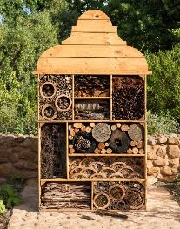
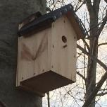
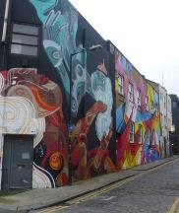
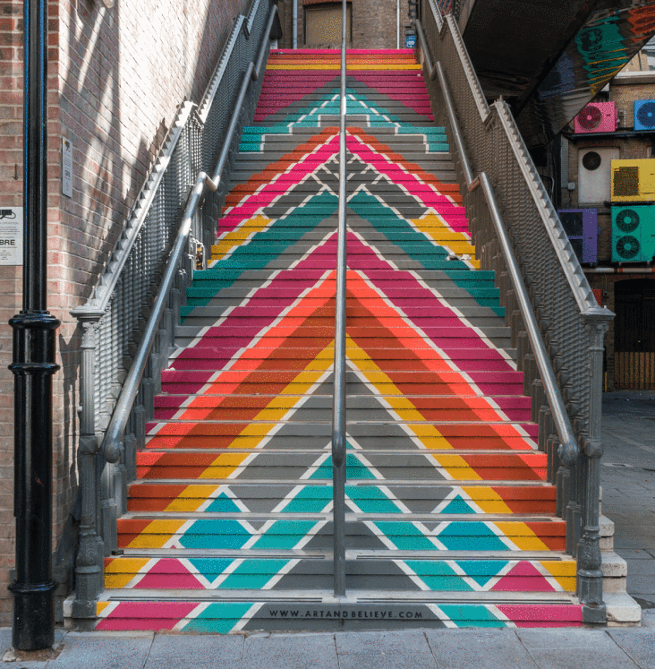
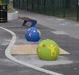
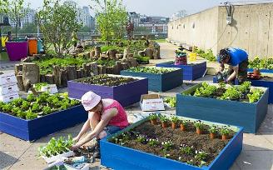
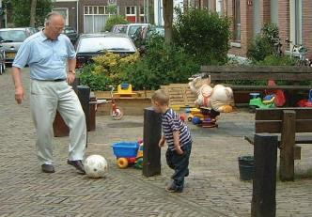
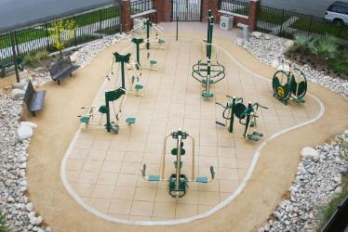
4. Things to see and do
To give a space to play and exercise to help keep us fit, active and healthy, as well as supporting good mental health.
Bird watching and bug hotels
Street art on walls
and floors
Street play
Exercise equipment
Fruit and vegetables
growing

Slide 7
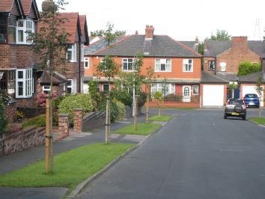
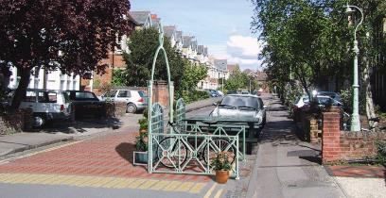
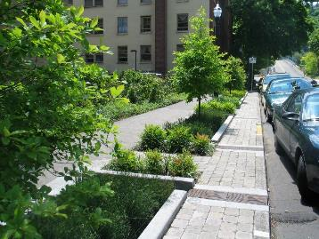
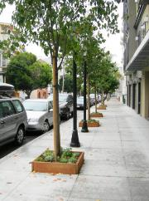
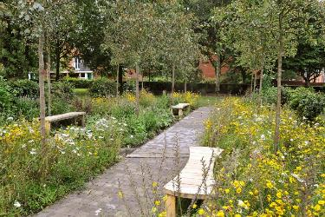
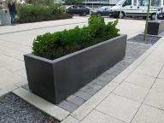
5. Greenery and planting
To give a space for trees and plants to grow, helping to clean the air, drain water and give a habitat for local wildlife.

Slide 8
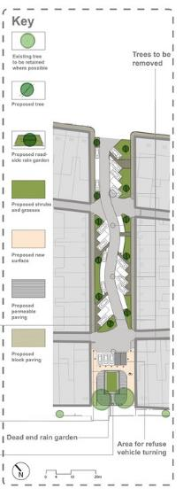
Let’s look at some streets that have been redesigned:
The photos on the next pages, are from a project called ‘Greener Grangetown’.
They show what a street looked like before the change, and after.
Discuss with a partner:
what changes have been made?
what category those changes are from?
https://www.arup.com/projects/greener-grangetown

Slide 9
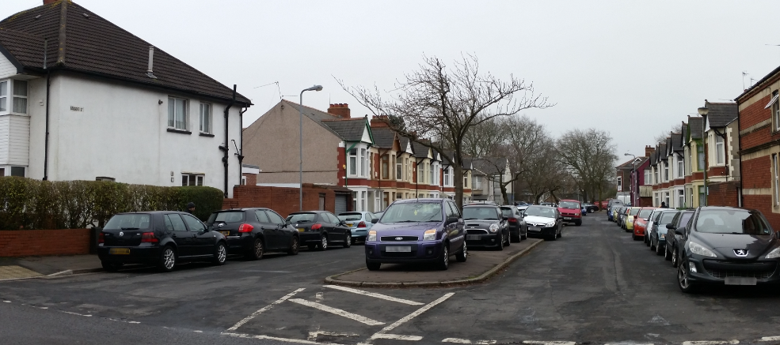
Before

Slide 10
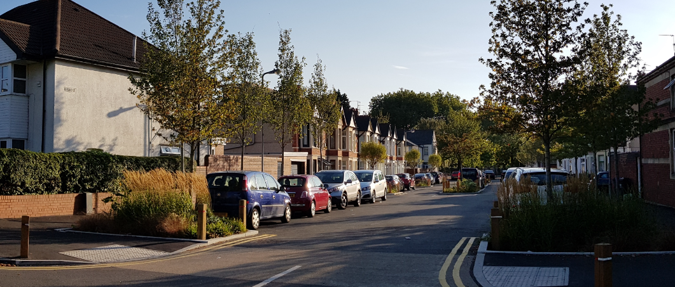
After

Slide 11
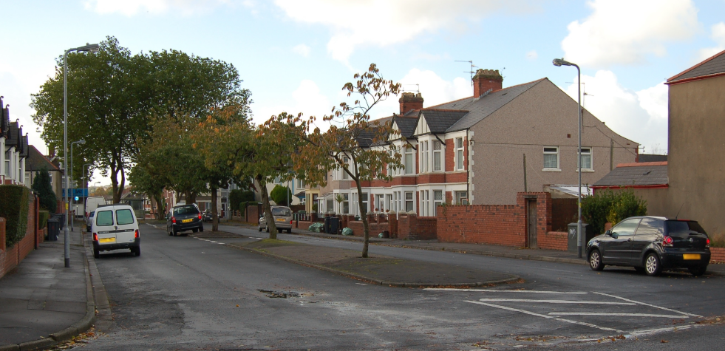
Before

Slide 12
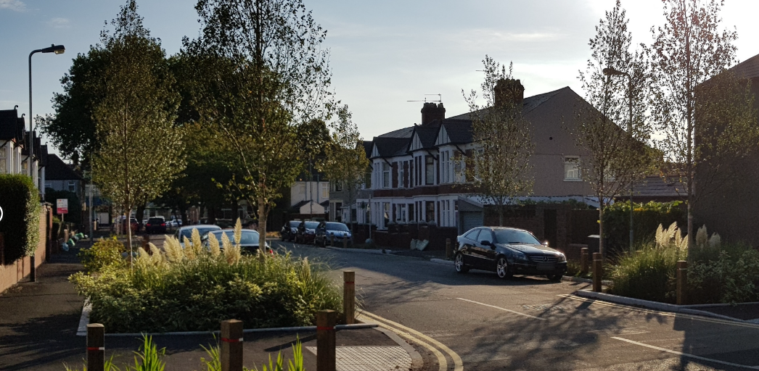
After

Slide 13
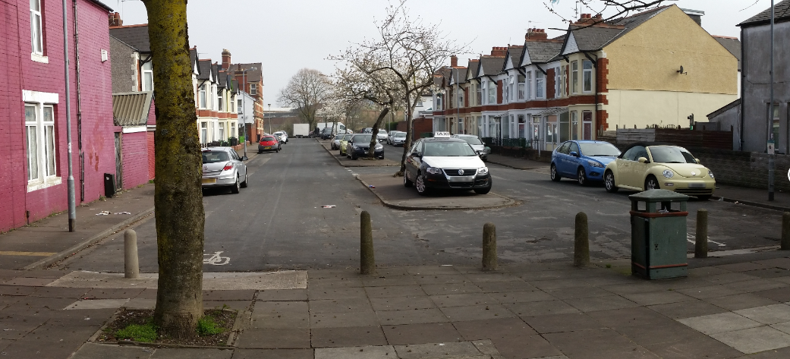
Before

Slide 14
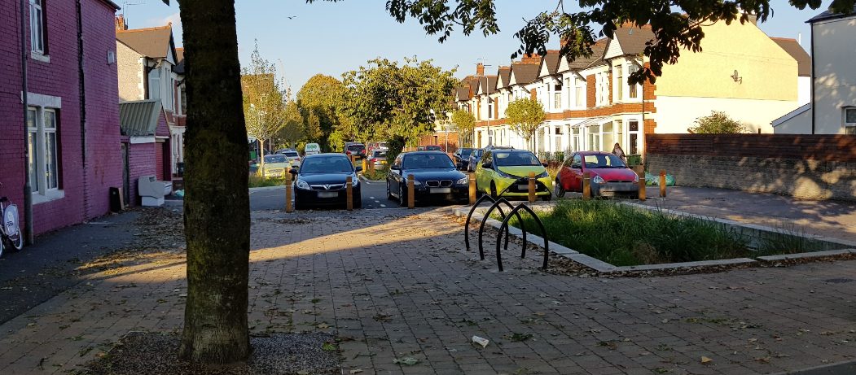
After

