Slide 1
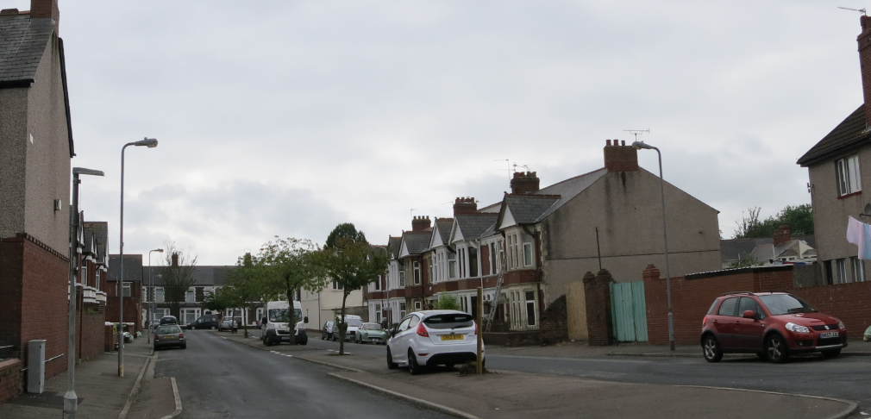
Before

Slide 2
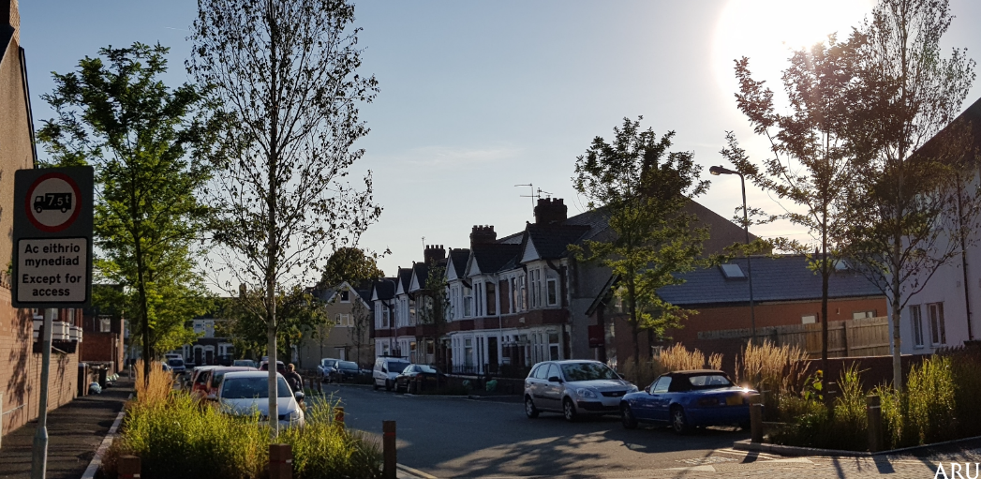
After

Slide 3
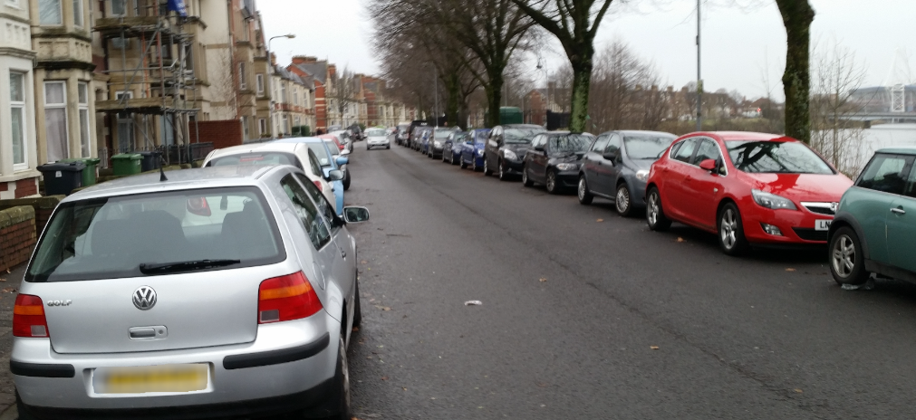
Before

Slide 4
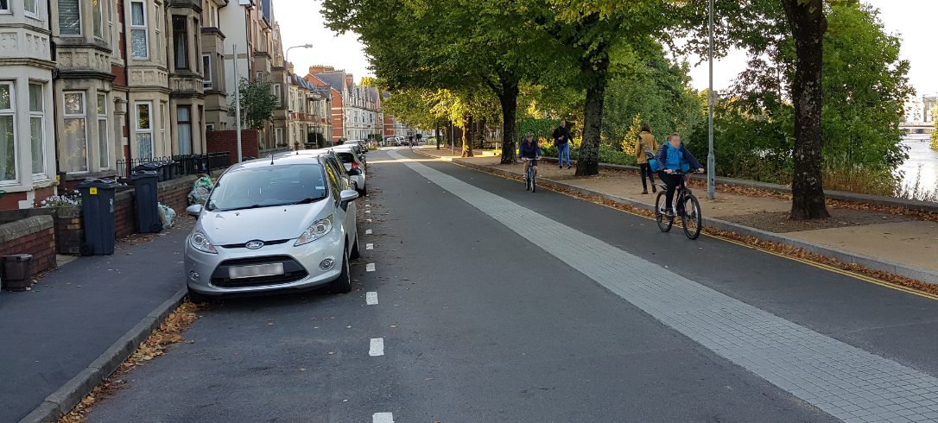
After

Slide 5
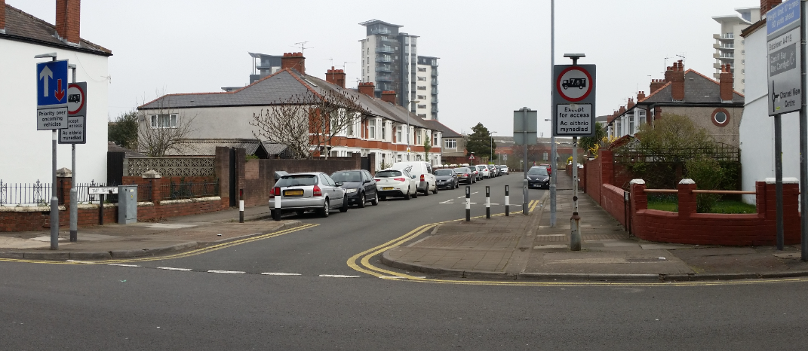
Before

Slide 6
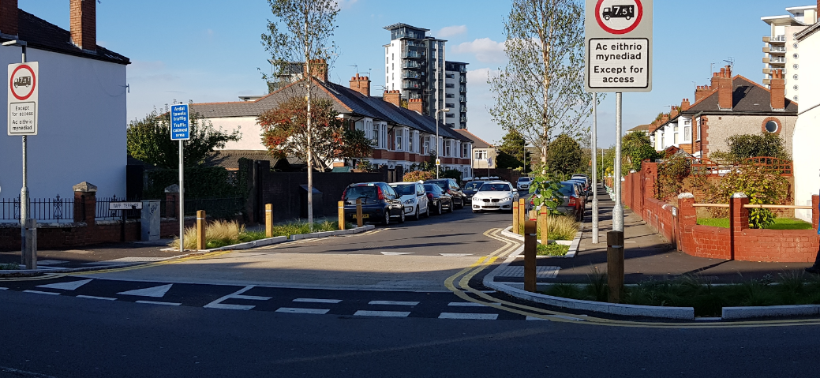
After

Slide 7
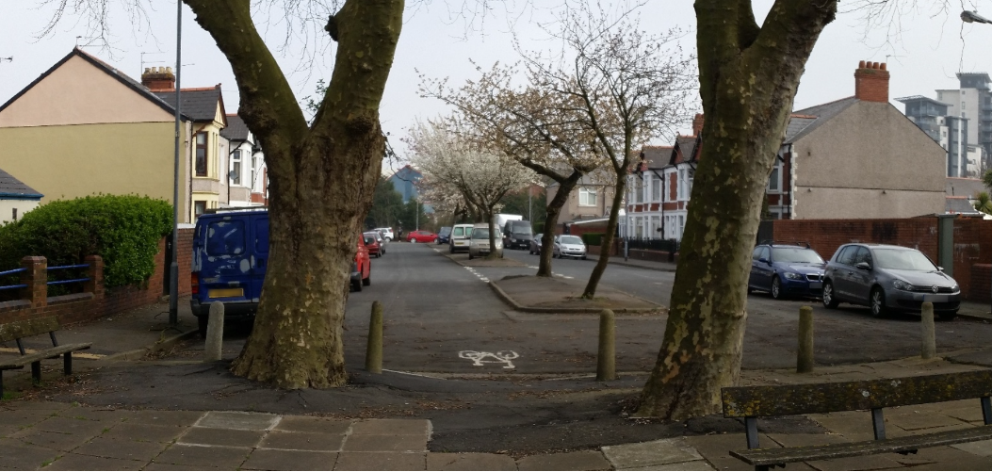
Before

Slide 8
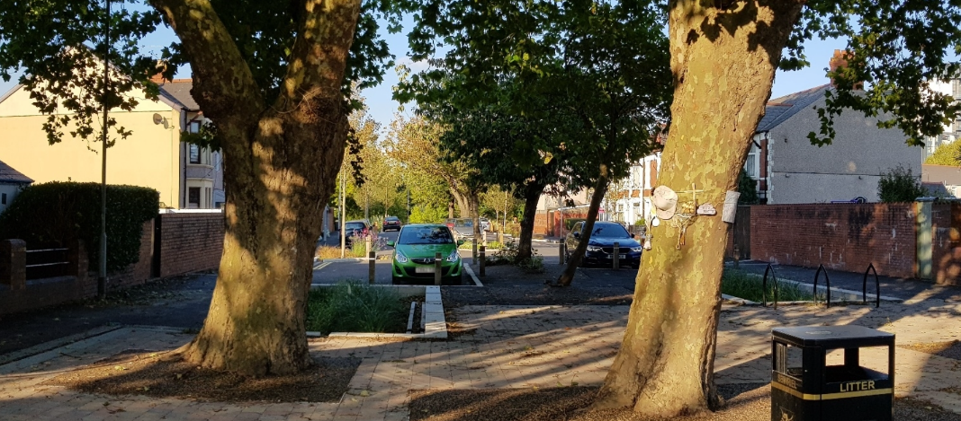
After

Slide 9
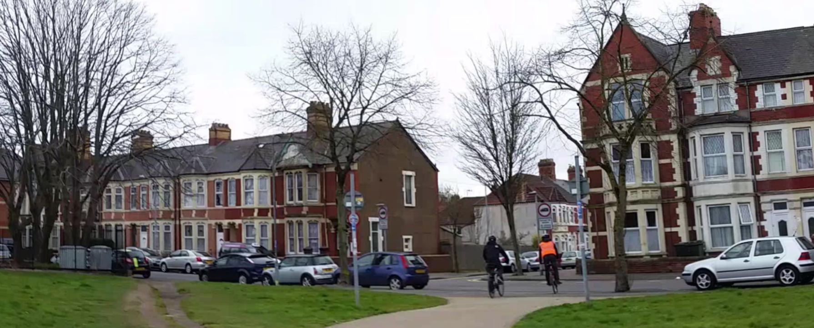
Before

Slide 10
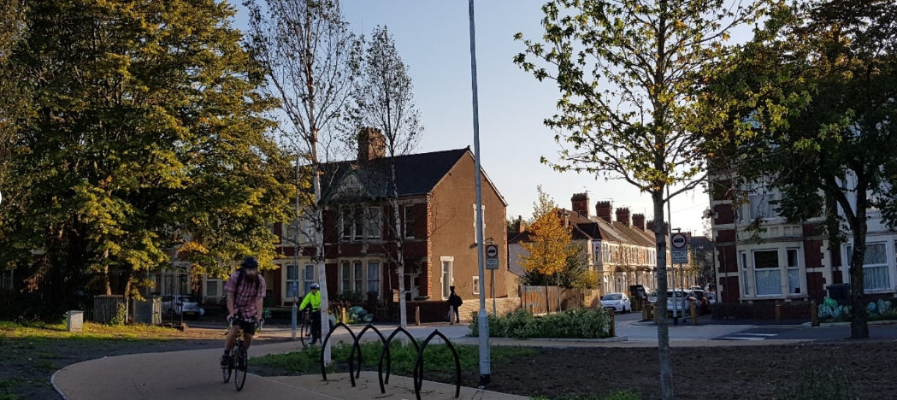
After

Slide 11
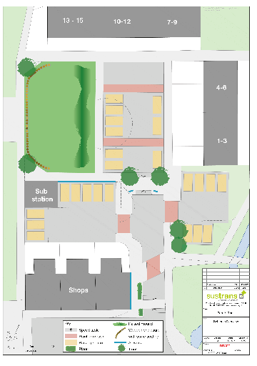
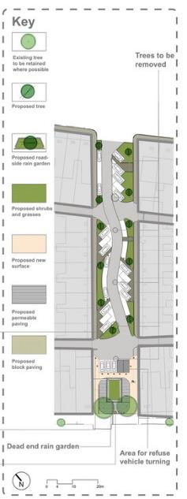
Have a look again at these
street designs….

Slide 12
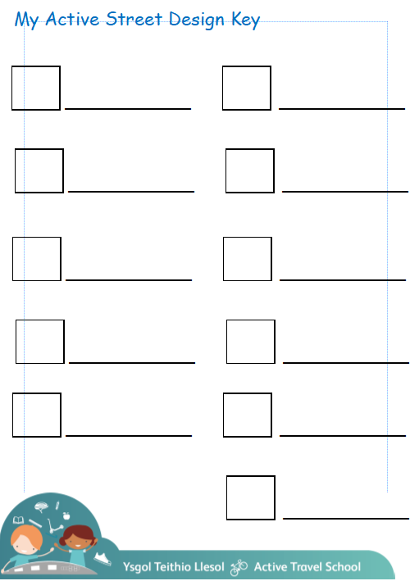
Now its time to change the design of the street outside your school.
First draw the outline of the street, make sure you include junctions and the main school building.
Using your Key to guide you, complete the design of your Active Street.

Slide 13
Plenary
Who do you need to share your plan with?
Your headteacher?
Your local councillor?
Your MP?
https://cardiff.moderngov.co.uk/uuCoverPage.aspx?bcr=1

Slide 14
Plenary
What have you learnt about active travel in all the lessons?
What do YOU need to change?
How can you influence others?

