Slide 1
Active Travel Lesson 2
Learning Objectives:
To understand what active travel is.
To understand the benefits of active travel.
To understand the importance of active travel to individuals and families, schools, communities and the planet.
What Matters:
Developing physical health and well-being has lifelong benefits.
Our decision making impacts on the quality of our lives and others.

Slide 2
Why is Active Travel important? What are the benefits?

Slide 3
Benefits

Slide 4
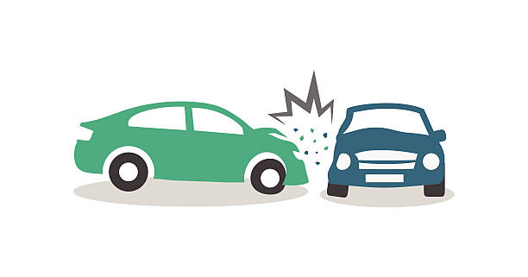
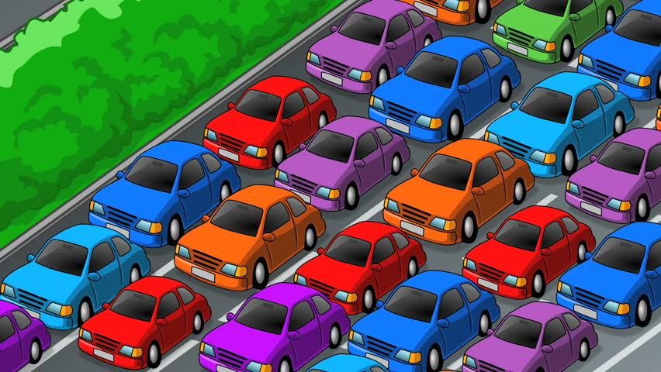
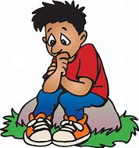
Less collisions
Improved health
Less congestion
Reduces stress and anxiety
Cheaper
Improves concentration
Less carbon emissions
Improves relationships

Slide 5
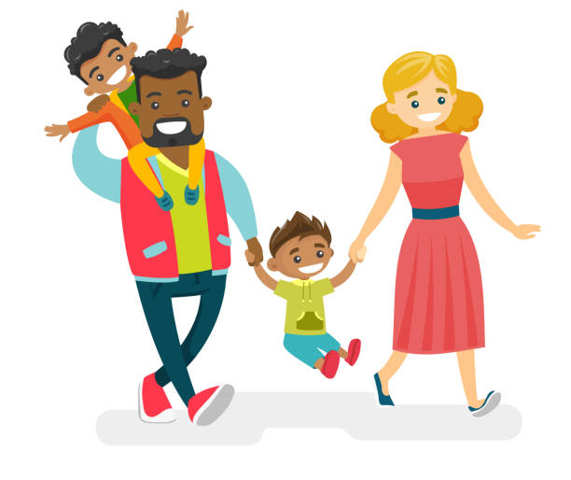
Who does active travel benefit?

Slide 6
Can you sort the benefits?
Individuals | Families
Communities | The Planet
Reduced anxiety and stress
More time to converse
Reduced road traffic collisions
Improved physical health
Reduced air pollution
Less car congestion
Increases concentration
Increase in spending in local shops
Reduced social isolation
Less noise pollution
Lower economic cost to NHS
Less carbon emissions
Less money spent
Children increased academic performance in school
More time to chat and converse
Improved relationships

Slide 7
How do you think the way you travel now will affect the way you travel as an adult?

