Slide 1
Learning Objective:
To understand what active travel is.

Slide 2
What is active travel?
What could it be?

Slide 3
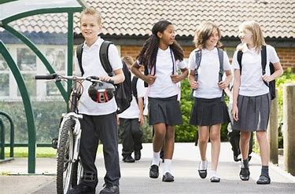
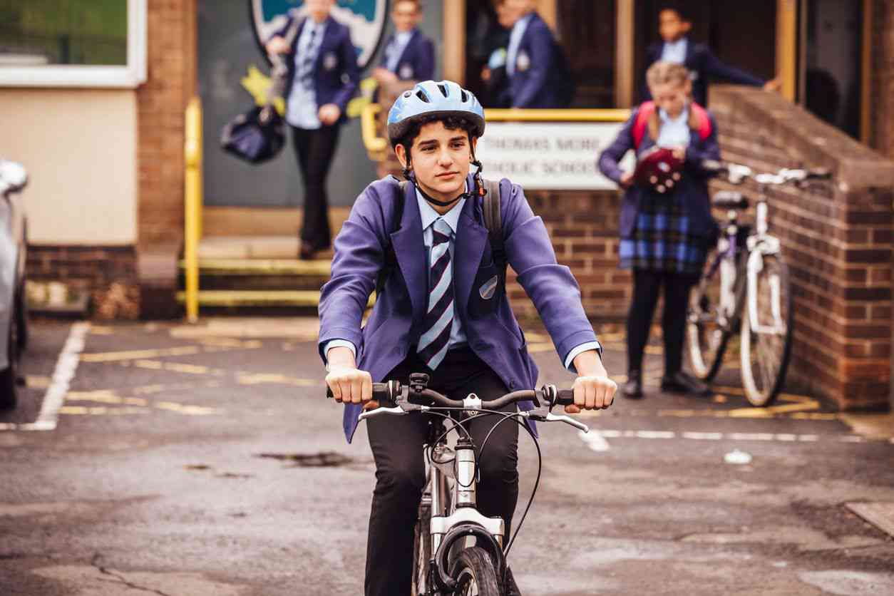
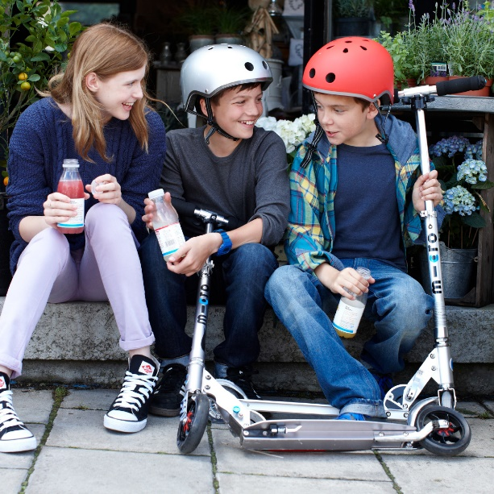
Ways of travelling which involve
exercise and moving your body.

Slide 4
Is walking active travel?

Slide 5
Is cycling active travel?

Slide 6
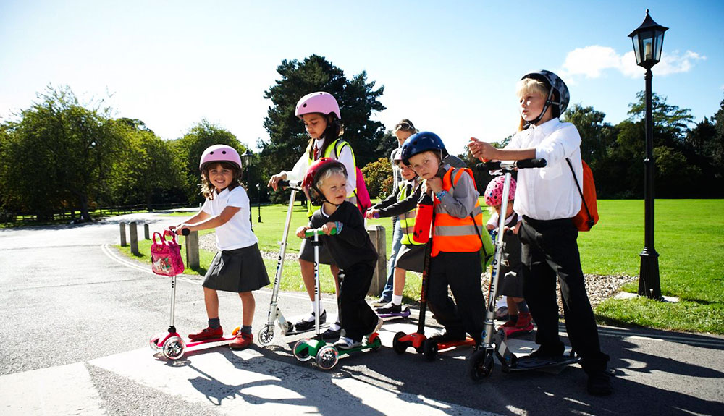
Is scooting active travel?

Slide 7
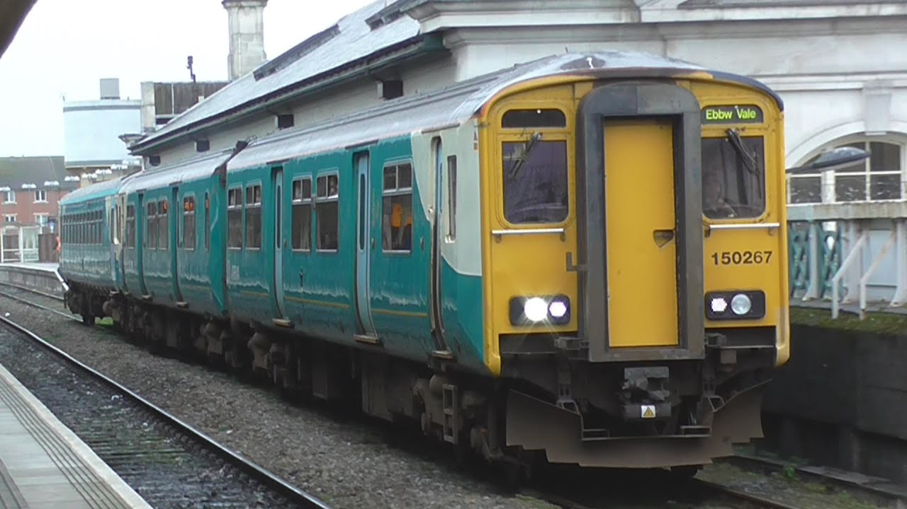
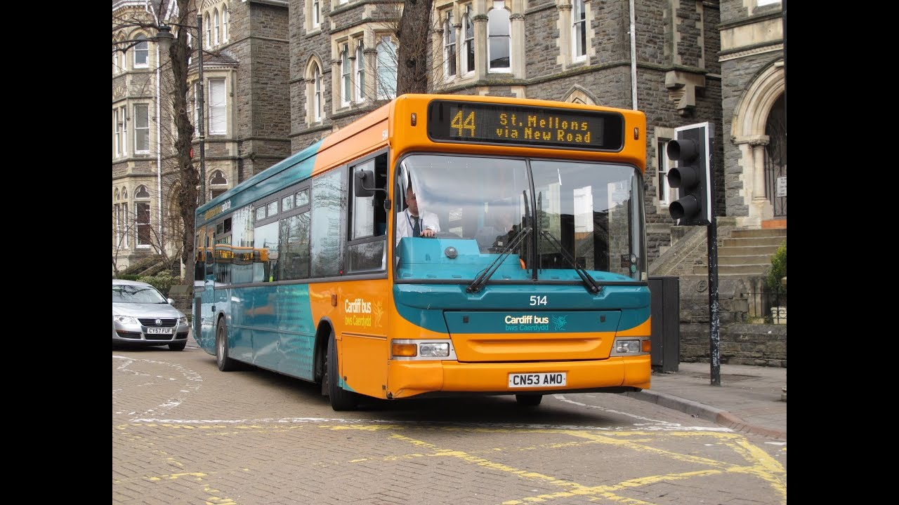
Is getting a bus or train active travel?
How far is your walk to the station or bus stop?
Could you get off a
stop earlier?

Slide 8
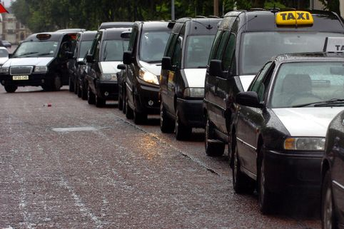
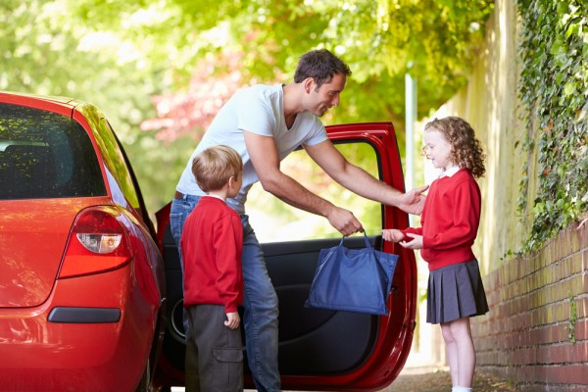
Is using a car or taxi active travel?
1 in 4 cars during rush hour is taking children to school
What about park and stride?

Slide 9
How did you travel to school today?

