Slide 1
Learning Objectives:
To understand that the reasons you don’t travel actively can be changed.

Slide 2
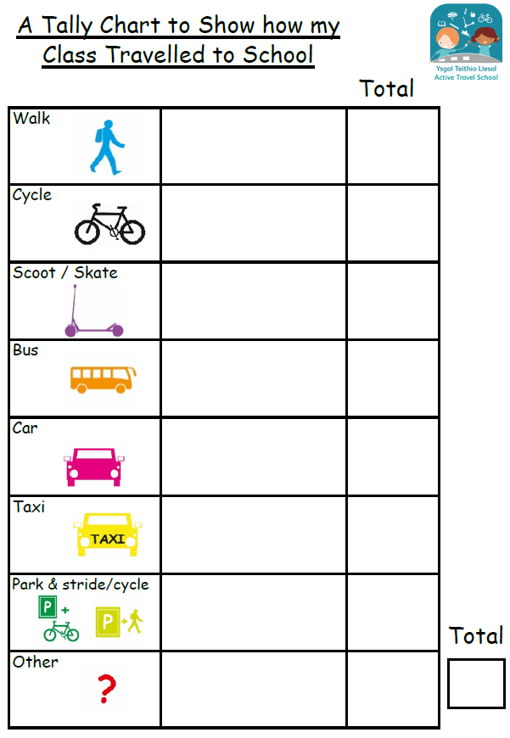
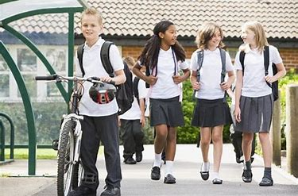
Some of you don’t travel actively…Why do people not travel actively?

Slide 3
Reasons not to travel actively

Slide 4
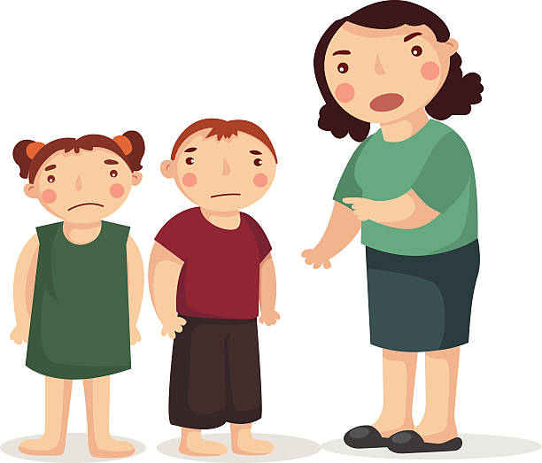
What phrases do you often hear your family saying when getting ready to go to school?
Write them on a whiteboard with a partner.

Slide 5
Did anyone mention these?
“Quick, put your shoes on!”
“Turn that off.”
“You’ll be in trouble if you’re late!”
“Hurry up!”
“You’re being too slow!”
“We are so late!”

Slide 6
Time is often a reason families drive instead of active travel…..
Most children live within 2 miles of their school.

Slide 7
Average walking speed is around 3 miles an hour.
Most cars in cities can travel between 20-30 miles an hour.

Slide 8
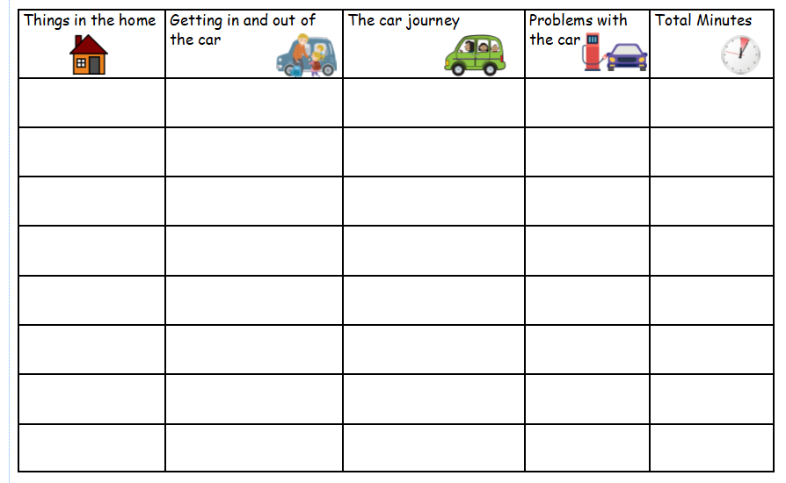
BUT………
What slows down a car journey?
Make a list as a pair or group.

Slide 9
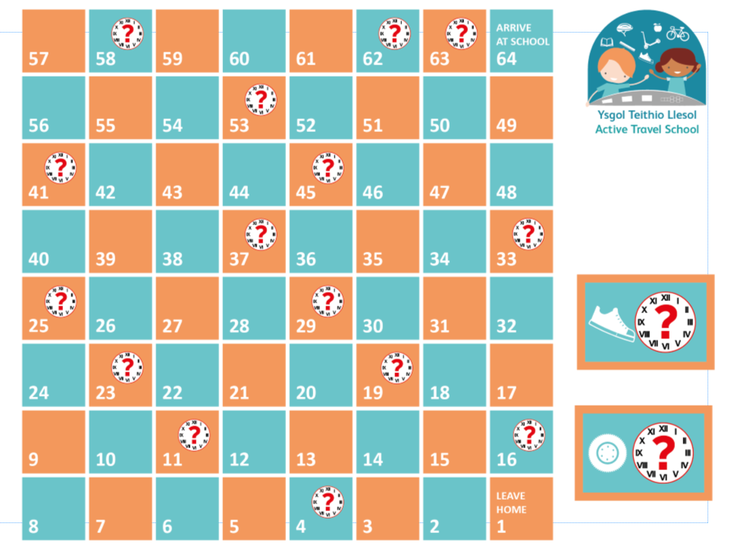
Play the game!

Slide 10
Plenary
What have you discovered this lesson?
Cars can sometimes be faster than walking, but not as fast as you first may think.
Does speed outweigh the other benefits if the speed is not as great as you first thought?

Slide 11
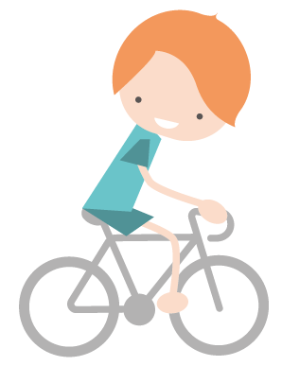
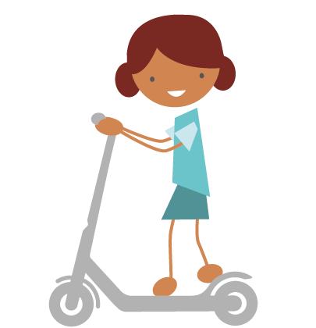
Plenary
What happens to the time if you cycle or scoot instead of walking?

