Slide 1
Active Travel Lesson 11
Learning Objective:
To be able to design an active street.
What Matters:
Developing physical health and well-being has lifelong benefits.
How we process and respond to our experiences affects our mental health and emotional well-being.
Our decision-making impacts on the quality of our lives and the lives of others.
How we engage with different social influences shapes who we are and our health and well-being.
Healthy relationships are fundamental to our sense of belonging and well-being.

Slide 2
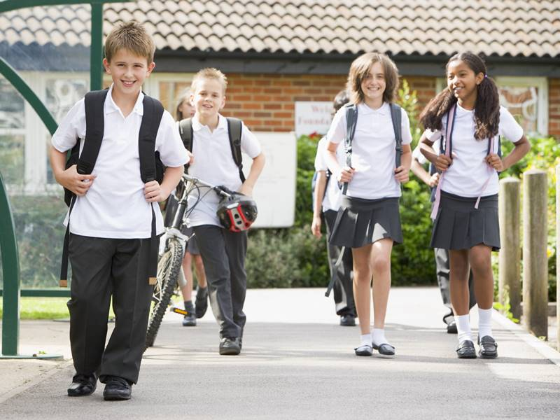
Did anyone try their new route?
What went well? Or didn’t?

Slide 3
What would persuade you to travel actively?
What changes should be made to streets?

Slide 4
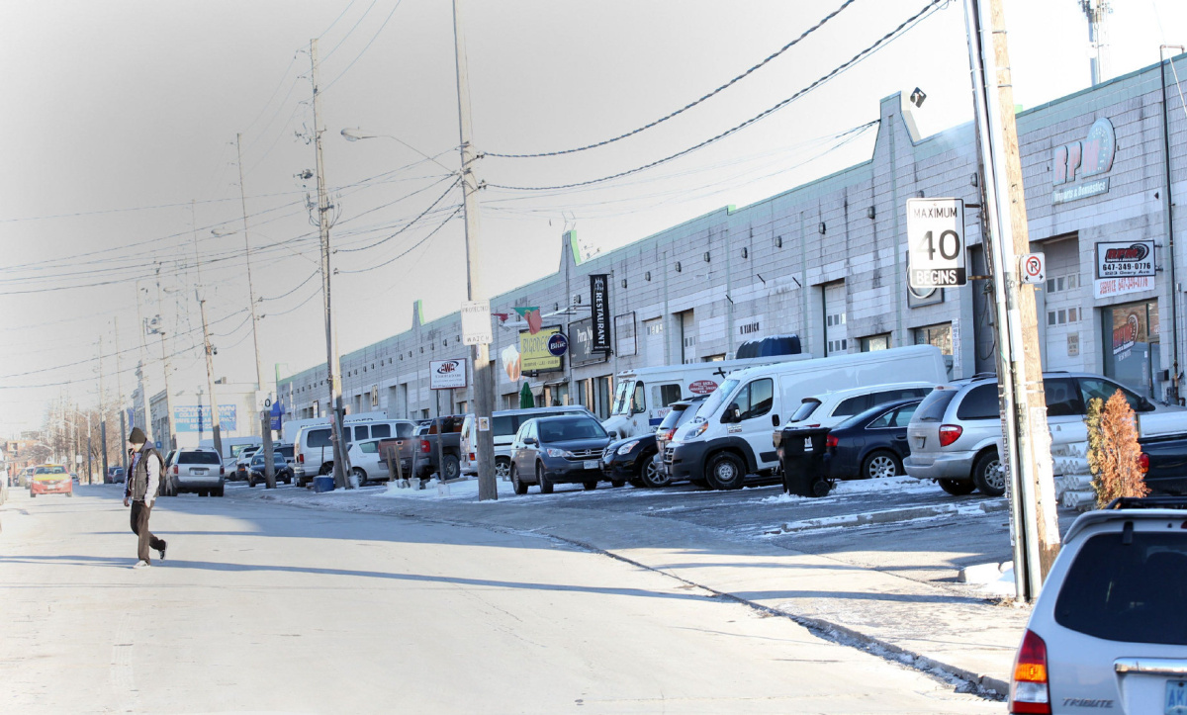
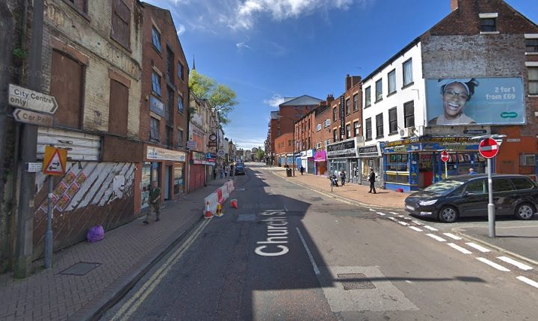
Would you want to walk or cycle on these streets?
Why not?

Slide 5
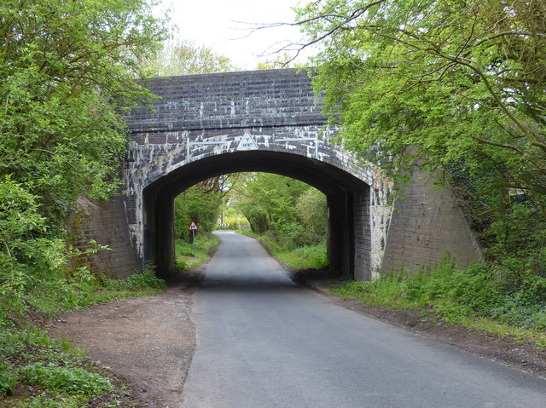
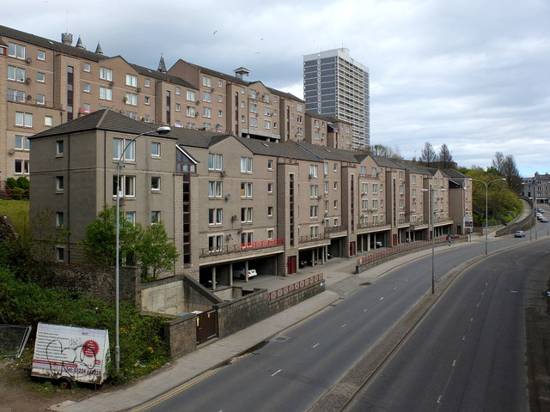
Would you want to walk or cycle on these streets?
Why not?

Slide 6
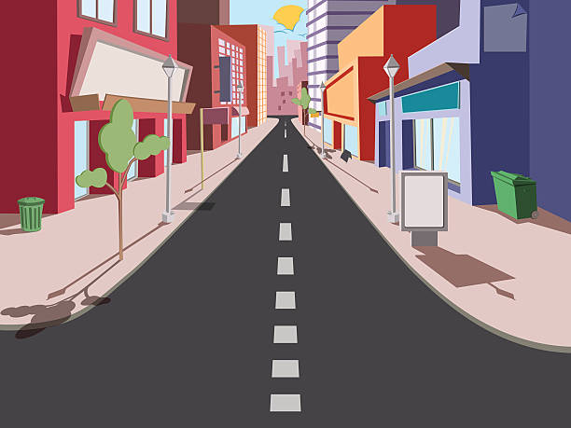
Streets in towns and cities are usually designed for vehicles.
But many other groups use streets.
Who else uses streets?

Slide 7
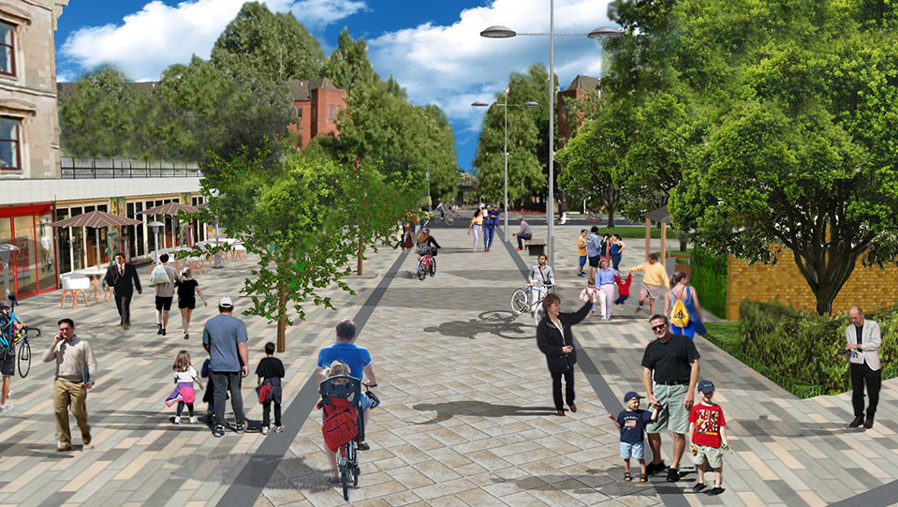
Who else uses streets?
Children playing
People socialising
People walking
People cycling
People exercising
Also wildlife – birds, frogs and hedgehogs can live in the streets around us

Slide 8
You are going to design an ‘Active Street’.
How would your street design make you want to cycle or walk to school?
Let’s look at the 5 categories:

Slide 9
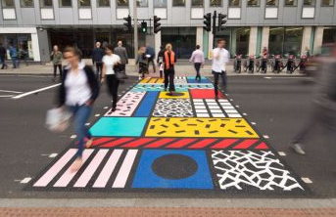
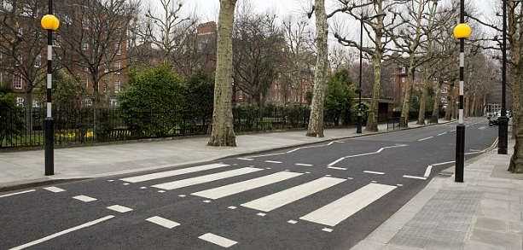
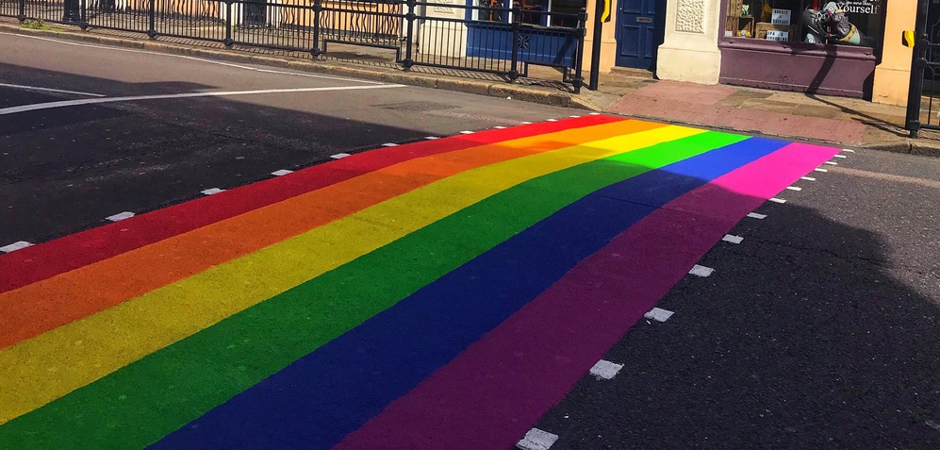
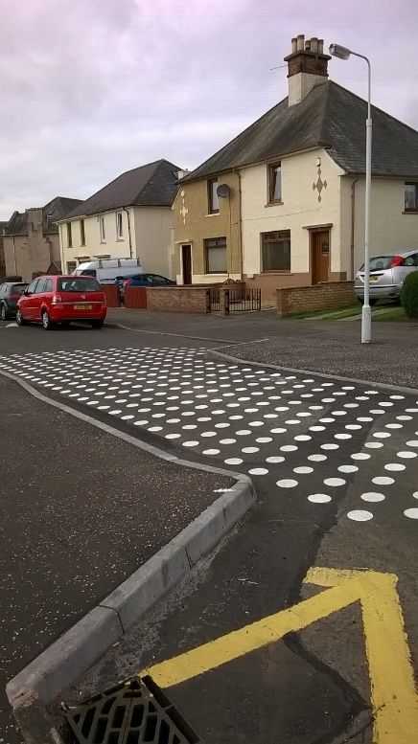
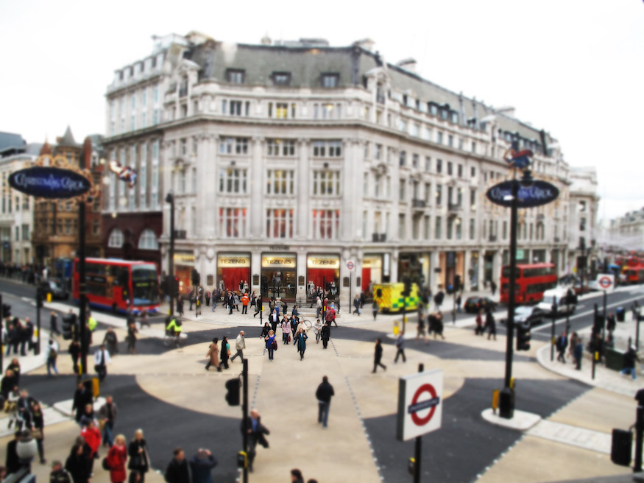
Easy roads to cross
To give a space to walk, cycle and scoot helping us get to places safely.
Colourful crossings
Zebra crossings
Diagonal crossings
Road narrowings
Raised crossings

Slide 10
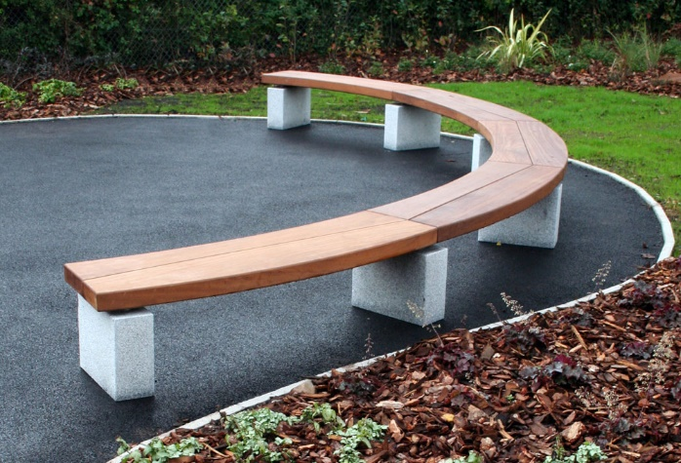
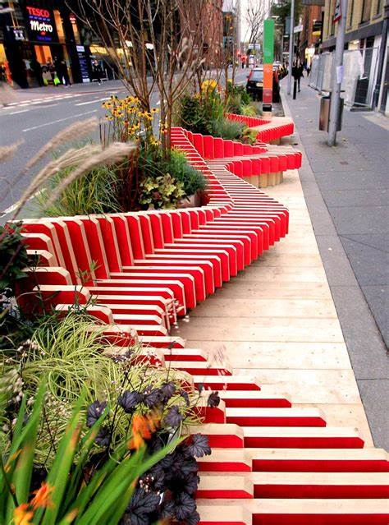
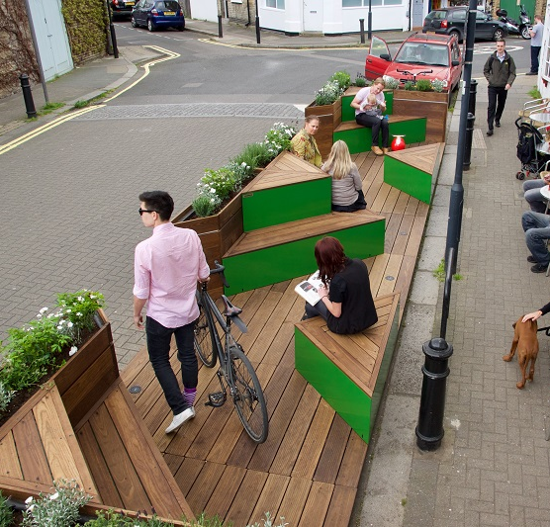
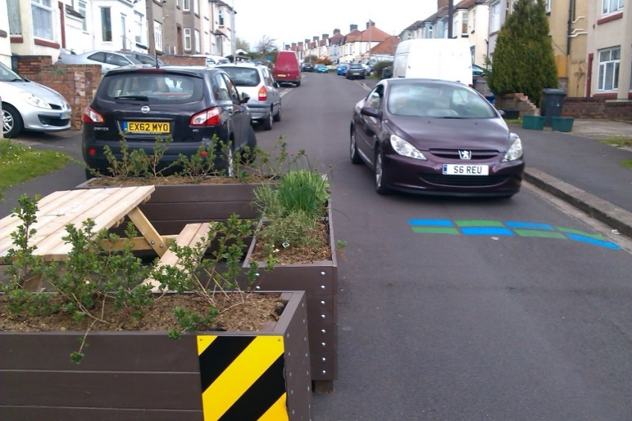
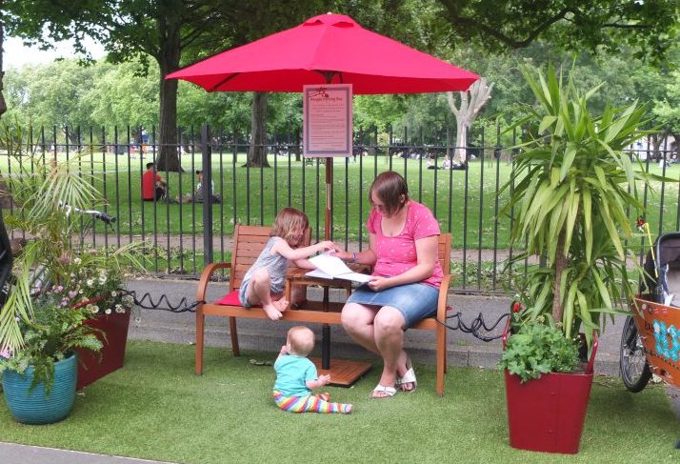
2. Places to stop and rest
To give space outdoors for people to talk to one another and give space to sit, rest and help us relax.
Benches
Parklets
Areas to relax
Grassy areas

Slide 11
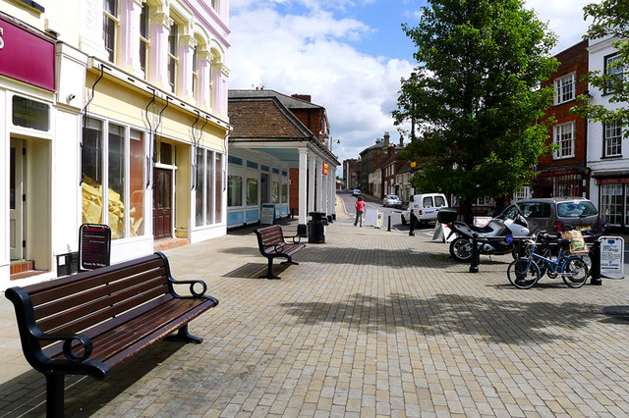
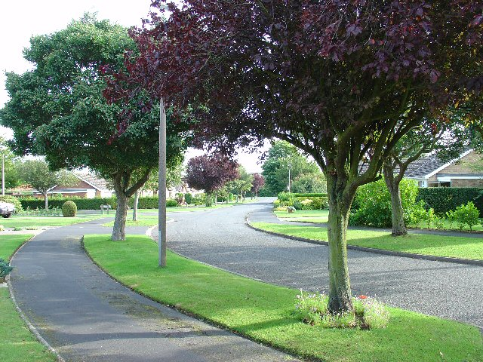
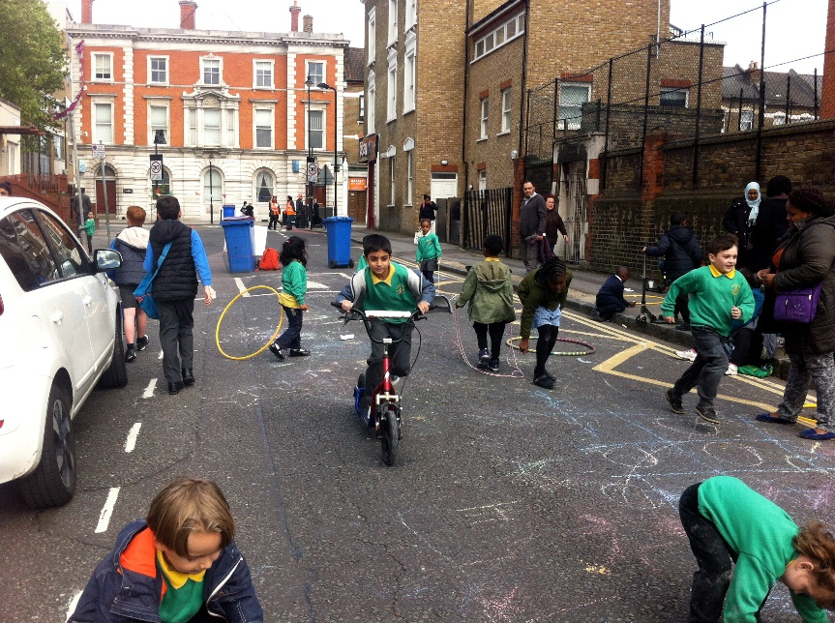
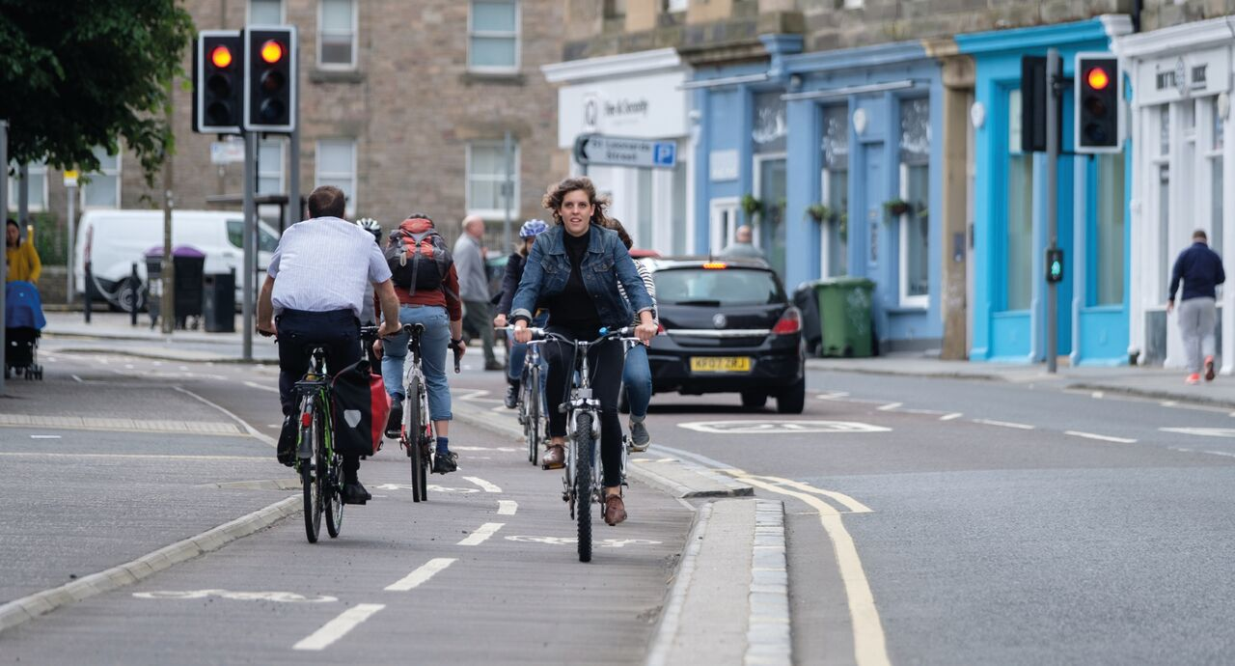
3. Makes active travel easier
To give a space to walk, cycle and scoot helping us get to places safely.
Wide pavements
Closing streets to cars
Cycle lanes

Slide 12
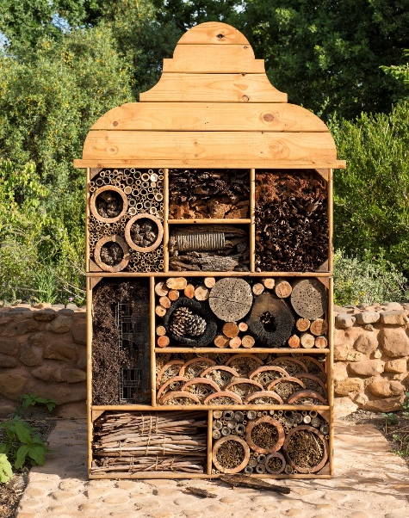
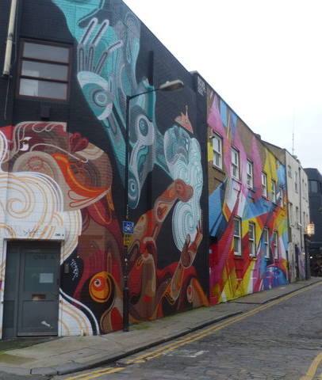
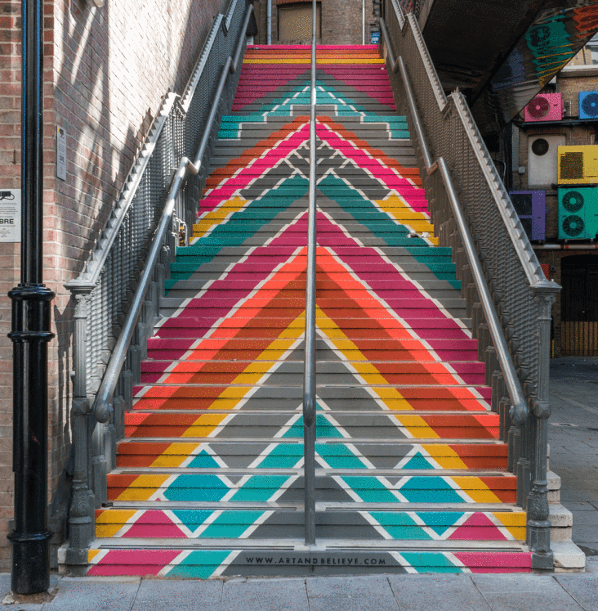
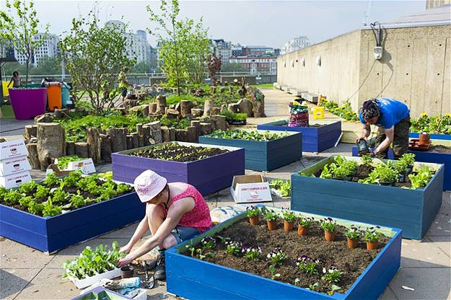
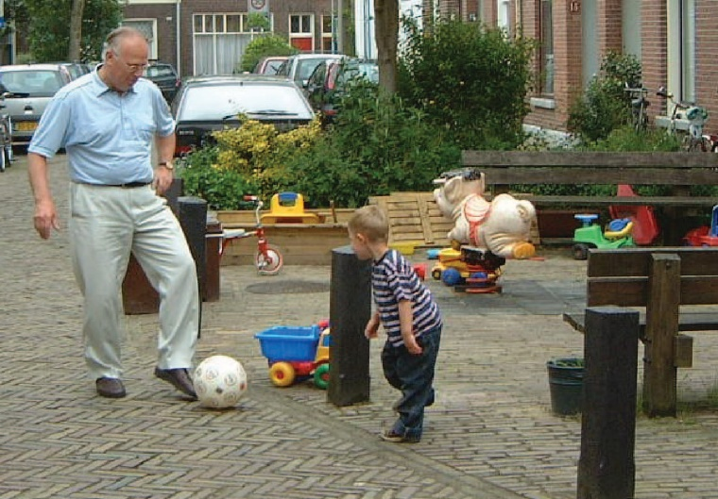
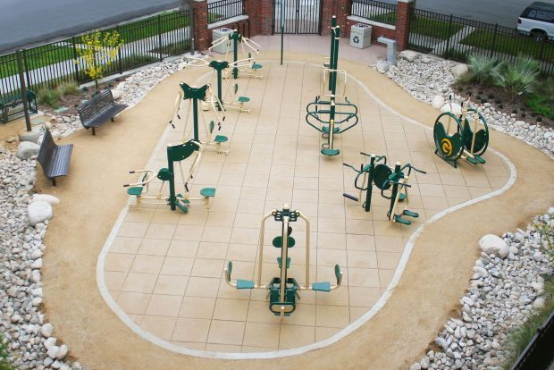
4. Things to see and do
To give a space to play and exercise to help keep us fit, active and healthy, as well as supporting good mental health.
Bird watching and bug hotels
Street art on walls
and floors
Street play
Exercise equipment
Fruit and vegetables
growing

Slide 13
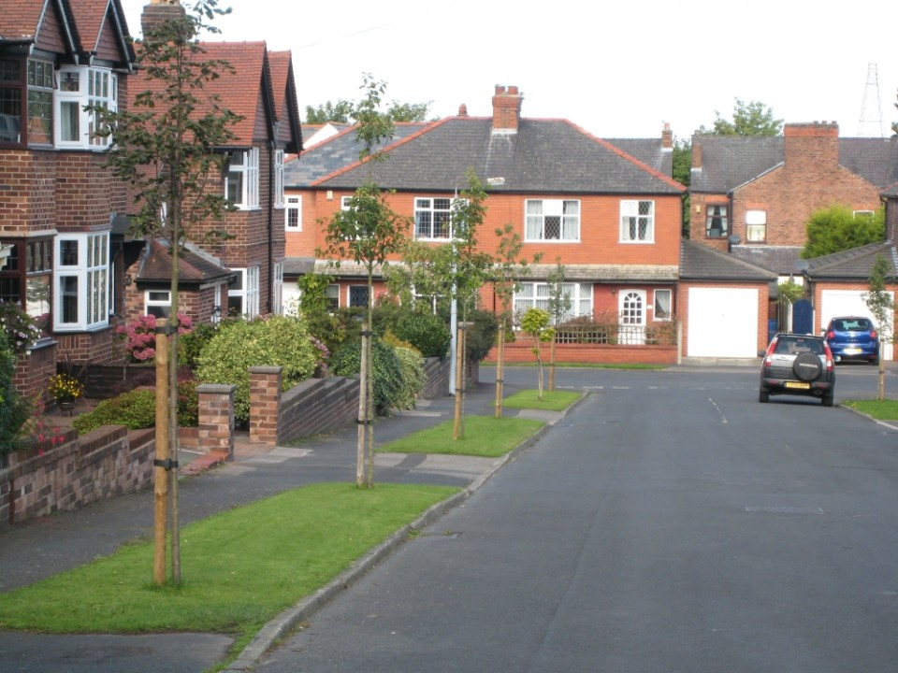
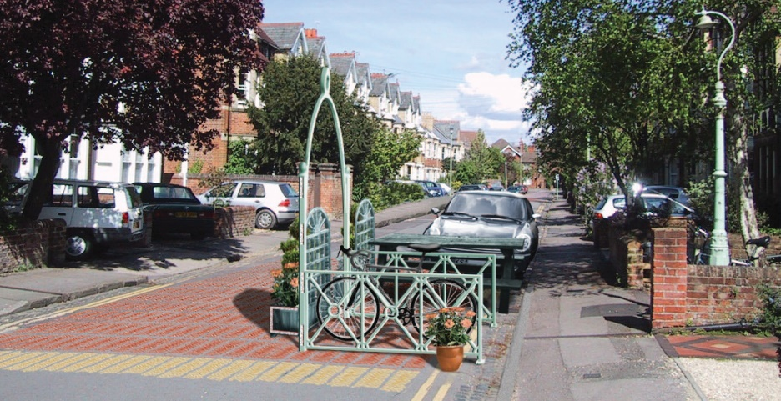
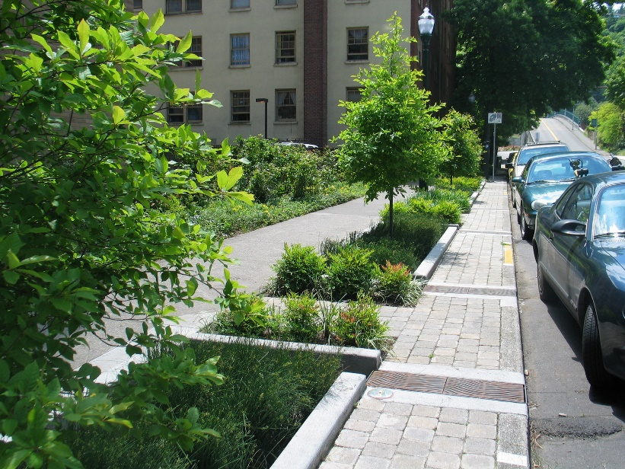
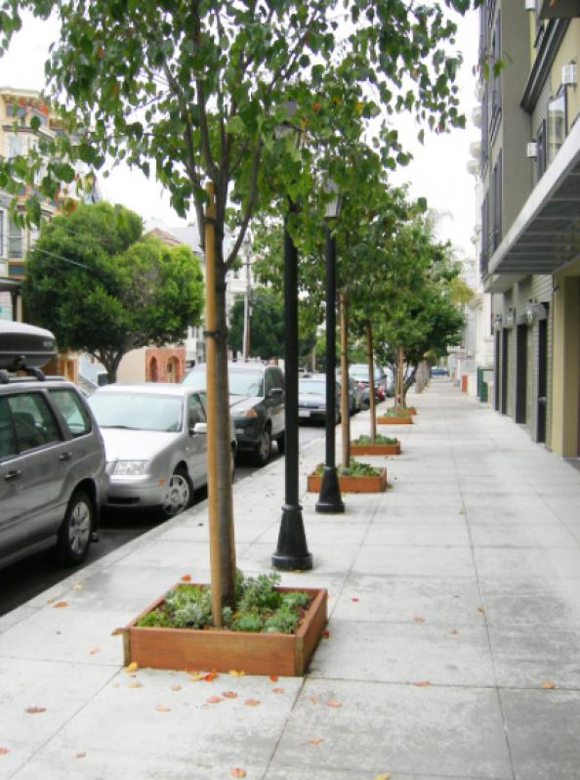
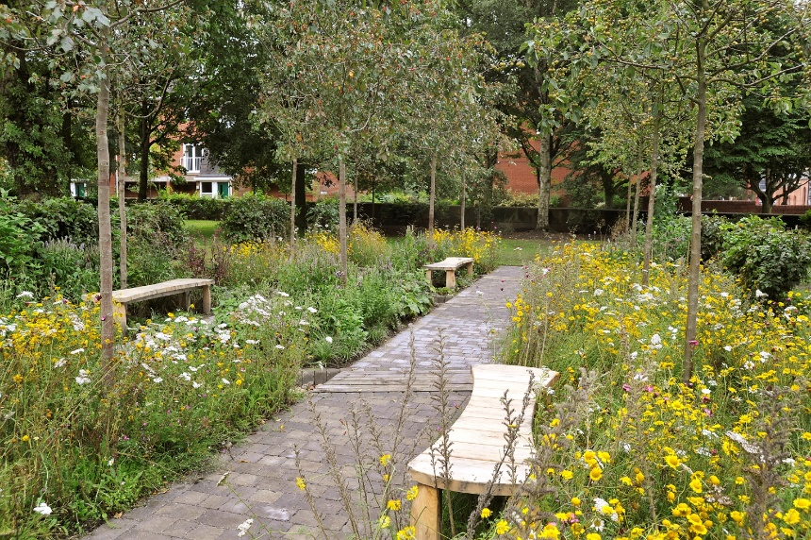
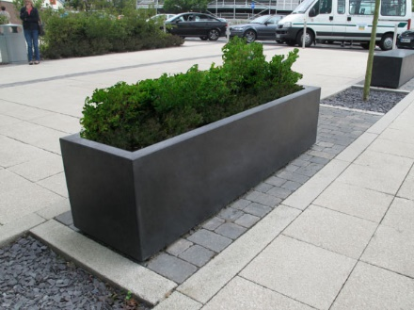
5. Greenery and planting
To give a space for trees and plants to grow, helping to clean the air, drain water and give a habitat for local wildlife.

Slide 14
You are going to design an ‘Active Street’, for the road outside your school.
What does a street design look like?

Slide 15
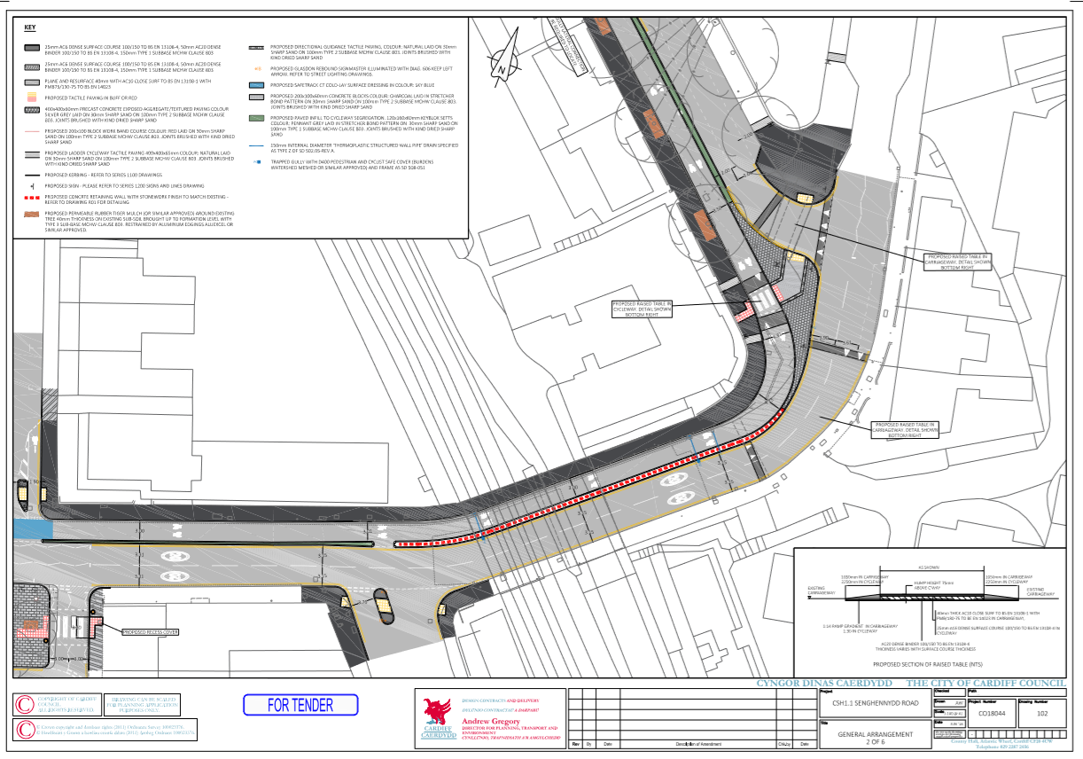
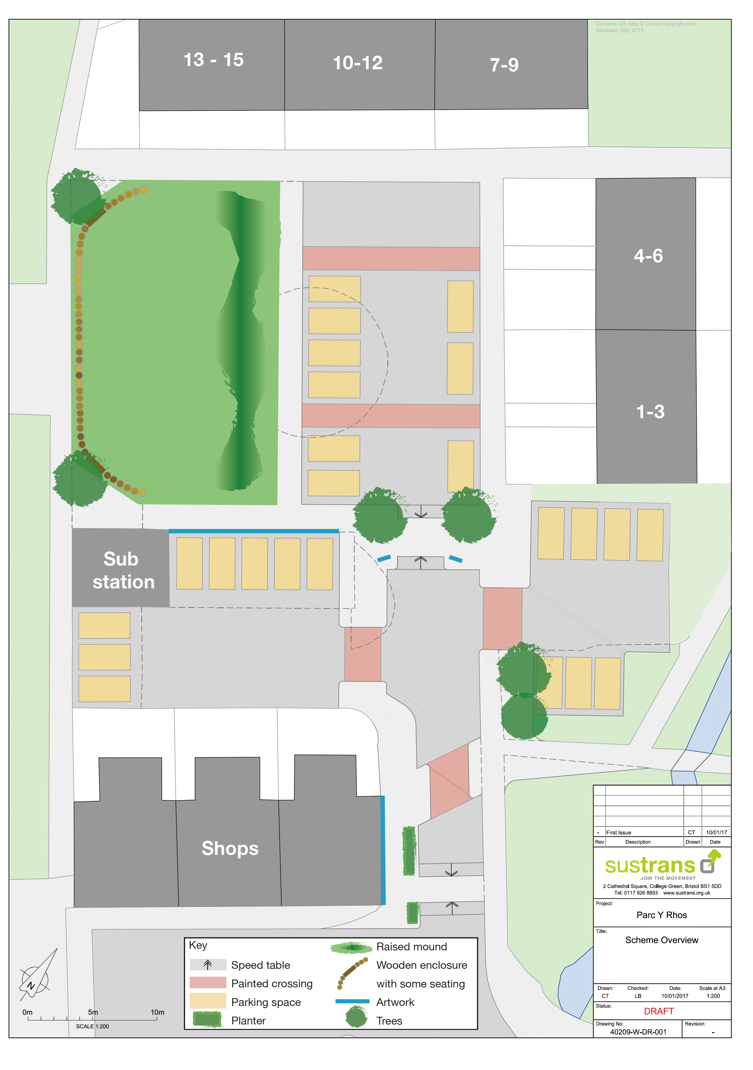
Here are some examples of street design…

Slide 16
What are these parts?
What is it for?

Slide 17
First create a Key for your design.
Using these 5 categories,
What will you put in your design?
Easy to cross
Places to stop and rest
3. Make active travel easier
4. Things to see and do
5. Greenery and planting

Slide 18
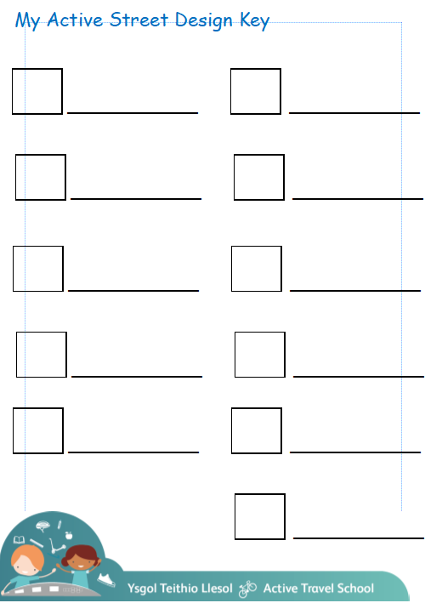
Categories to include:
1. Easy to cross
2. Places to stop and rest
3. Make active travel easier
4. Things to see and do
5. Greenery and planting

Slide 19
Plenary
As a group, check each persons key,
that it has each of the categories.
Categories to include:
1. Easy to cross
2. Places to stop and rest
3. Make active travel easier
4. Things to see and do
5. Greenery and planting

