Slide 1
Active Travel Lesson 7
Learning Objectives:
To understand the negative aspects of active travel can often have a solution.
What Matters:
Our decision-making impacts on the quality of our lives and the lives of others.

Slide 2
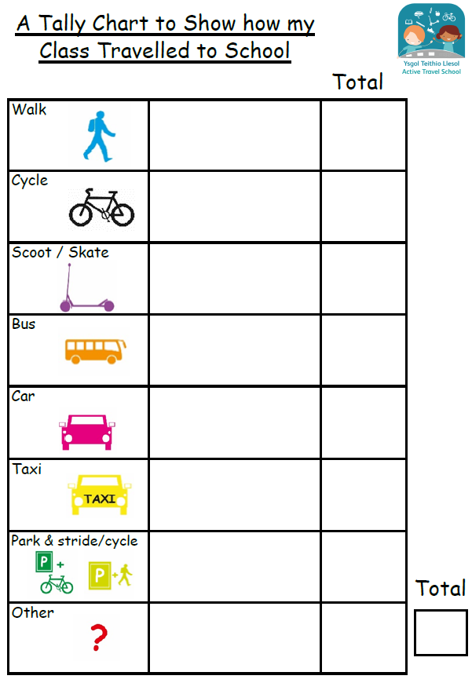
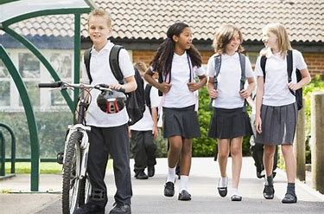
Some of you don’t travel actively…Why do people not travel actively?

Slide 3
Was bad weather one of the reasons not to travel actively?

Slide 4
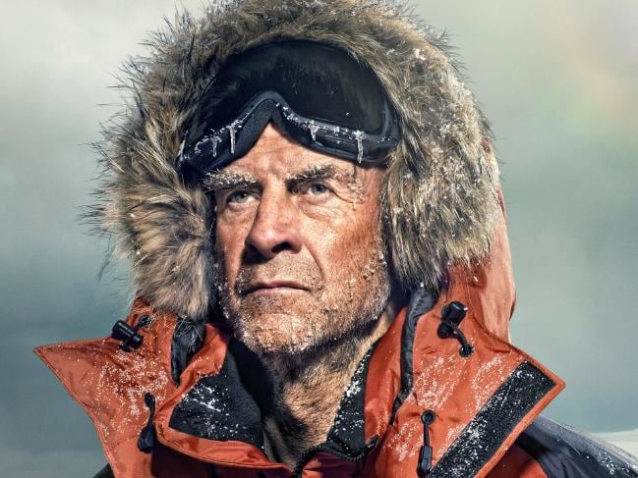
British Explorer

Slide 5
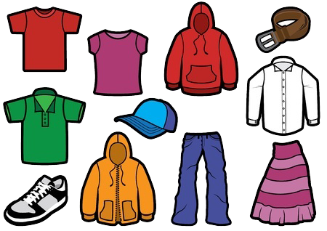
What do you wear to school?
What would you need to change if you were travelling actively to school?

Slide 6
How should clothing be changed if the weather were……
Sunny?
Rainy?
Snowy or icy?

Slide 7
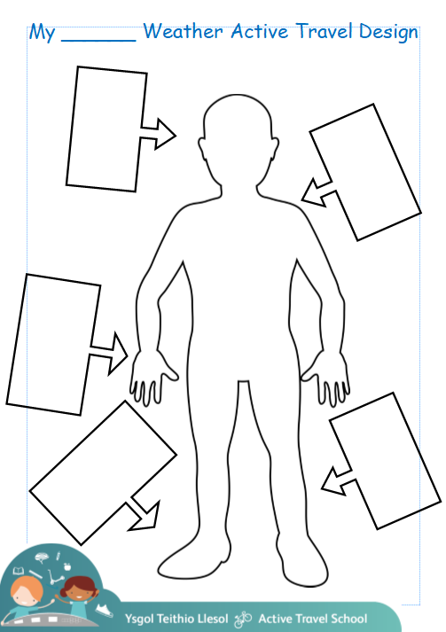
Design an outfit to walk to school.
Sunny, rainy, snowy or icy?

Slide 8
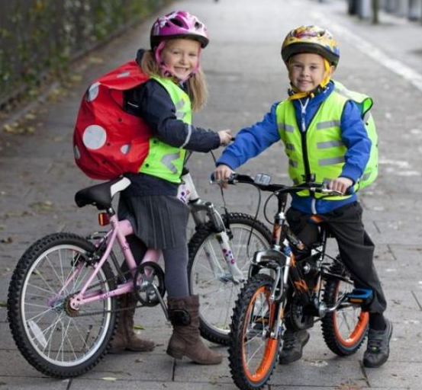
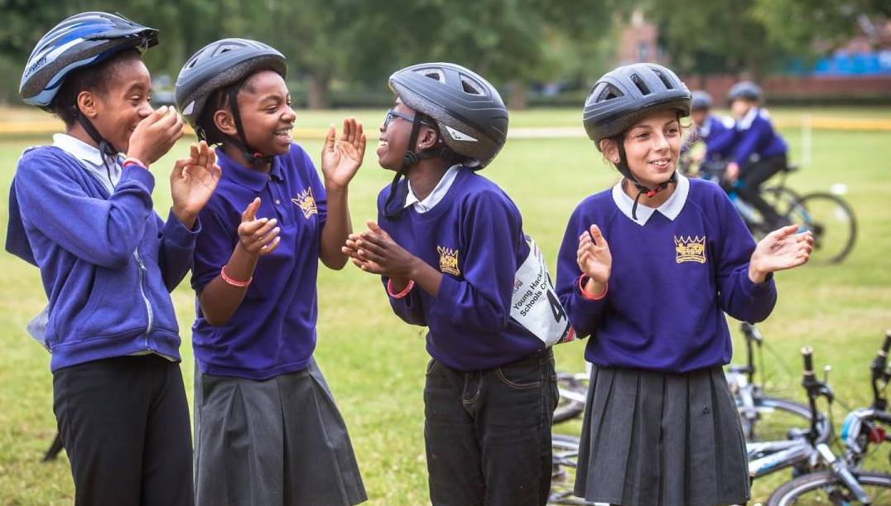
Plenary
How would your outfit change if you were cycling?

