Slide 1
Active Travel Lesson 8
Learning Objectives:
To understand the negative aspects of active travel can often have a solution.
What Matters:
How we process and respond to our experiences affects our mental health and emotional well-being.
Our decision-making impacts on the quality of our lives and the lives of others.

Slide 2
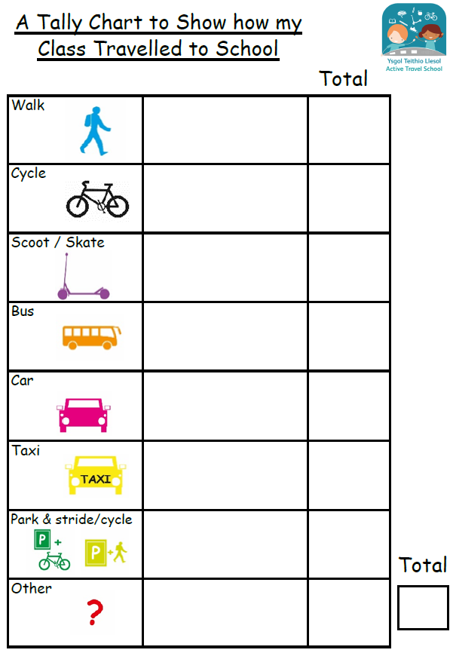
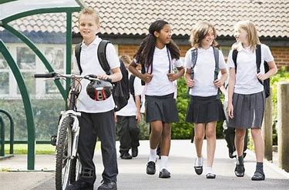
Some of you don’t travel actively…Why do people not travel actively?

Slide 3
Was road safety one of the reasons not to travel actively?
What are the main problems on your route to school?

Slide 4
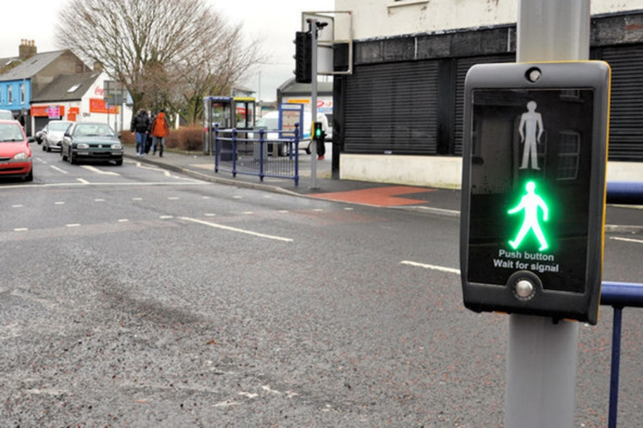
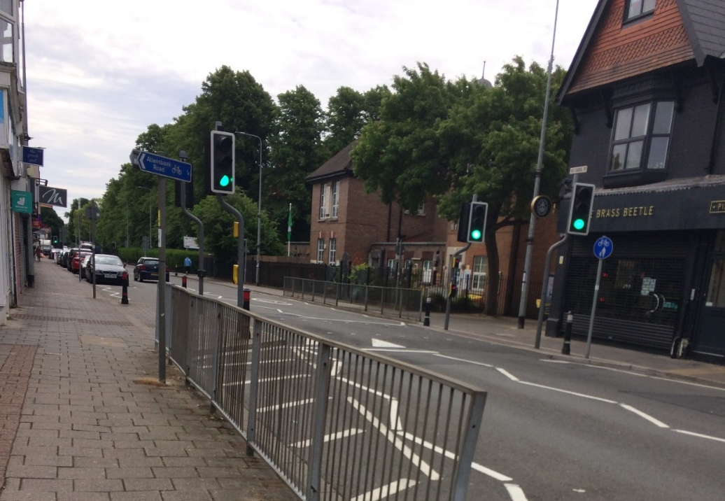
Discuss these obstacles:
Do you have them on your route? How do you approach them safely?
Pelican and Puffin Crossing

Slide 5
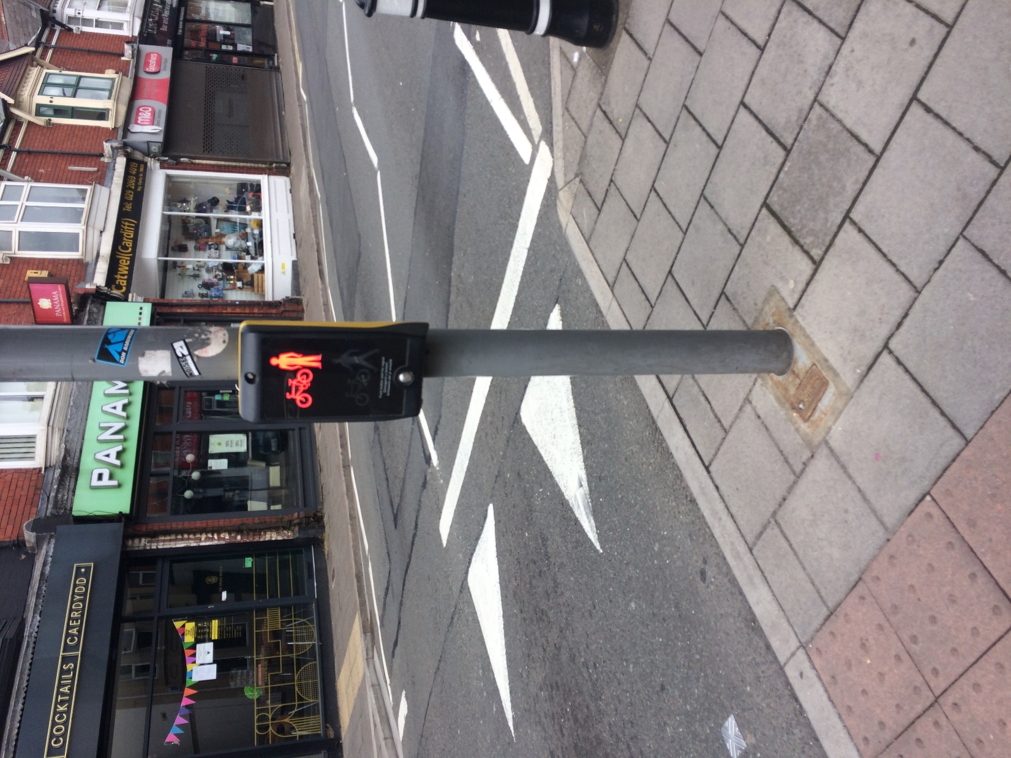
Toucan Crossing
Bicycle and pedestrian crossing

Slide 6
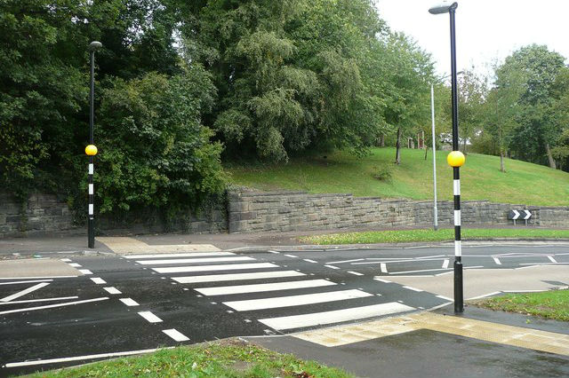
Zebra Crossing

Slide 7
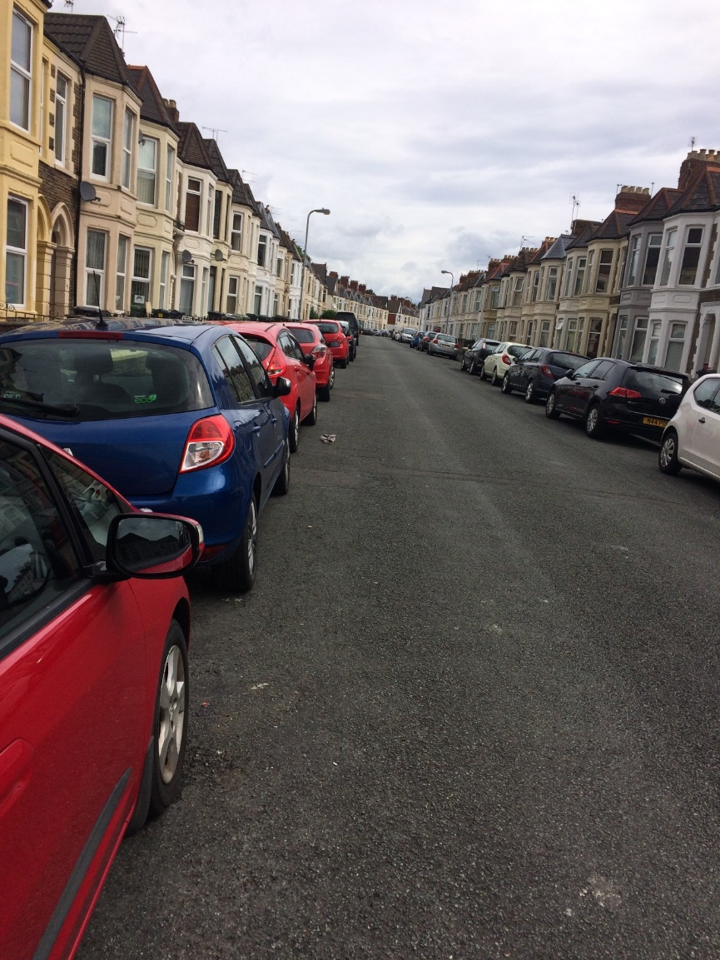
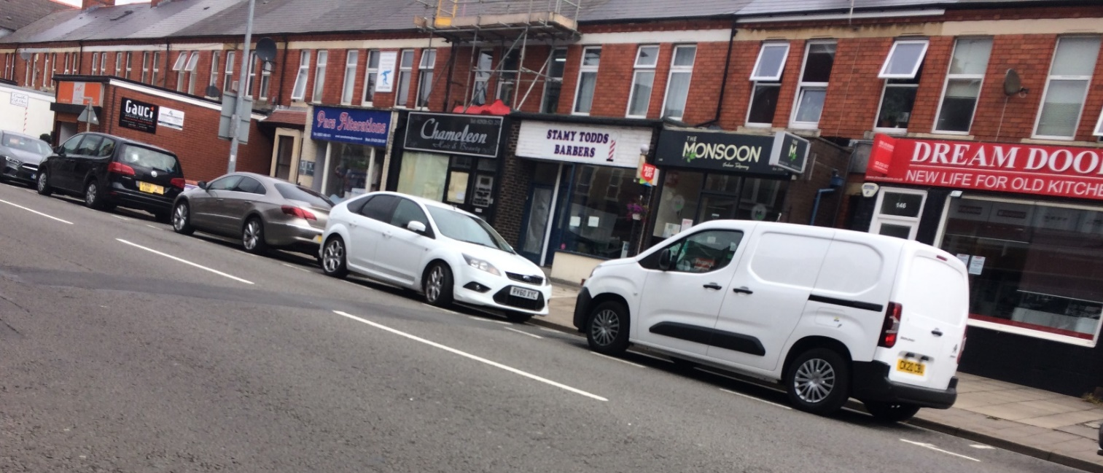
Parked cars

Slide 8
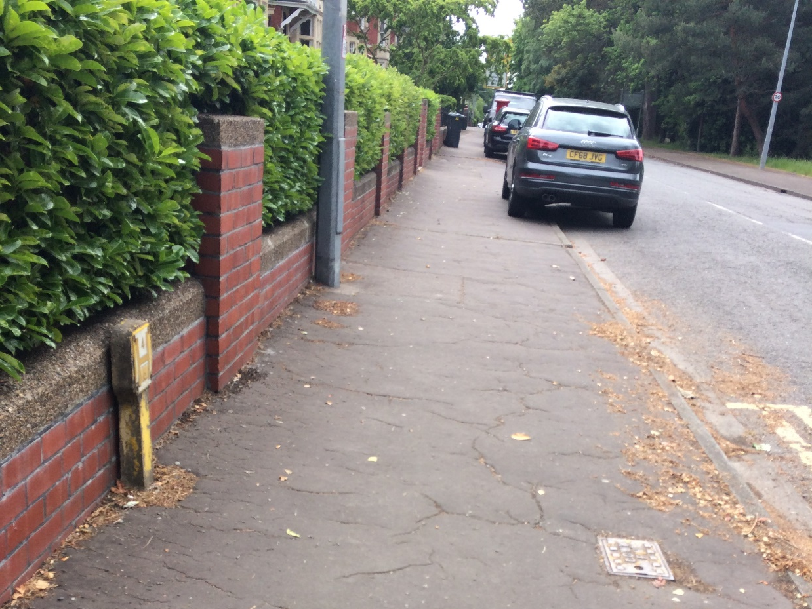
Pavement parking

Slide 9
Traffic Island

Slide 10
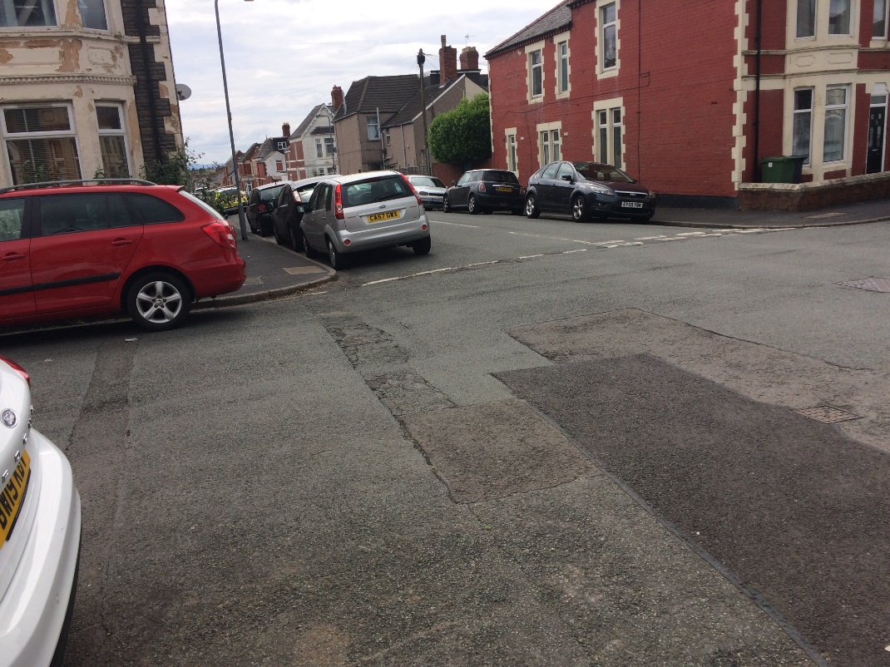
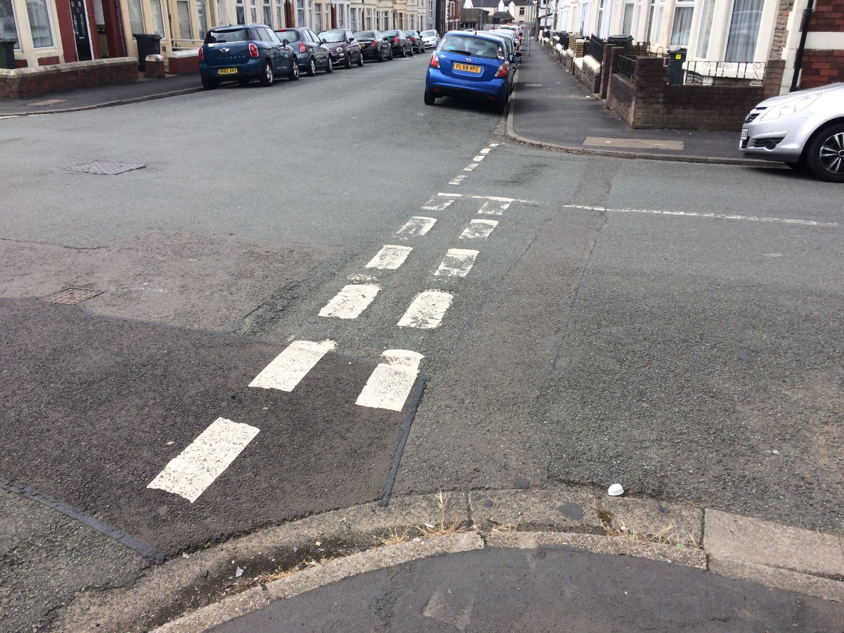
Junctions

Slide 11
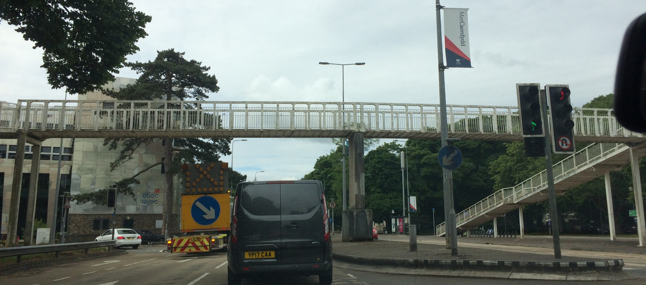
Footbridge

Slide 12
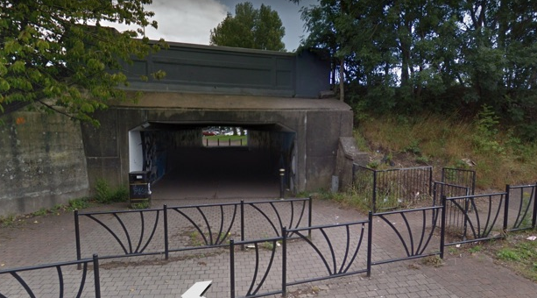
Underpass

Slide 13
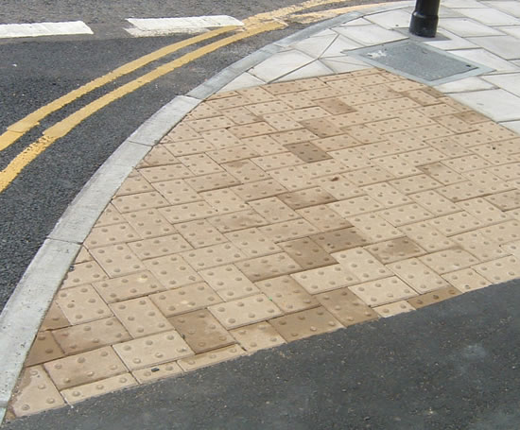
Tactile pavements
What does this do? How can we use it?

Slide 14
Play the Game as a pair
https://www.think.gov.uk/resource/take-the-lead-game/

Slide 15
Mindmap how to be safe with an obstacle as a group

Slide 16
Make a short play showing a safe way, and an unsafe way to use the obstacle.
Then, show your class.

Slide 17
Plenary
Look up your school on the Think Map.
Why are the accidents in those locations?
https://www.think.gov.uk/thinkmap/

